Slide 1
How to conduct an
in-person and virtual VBS
Baverley Sabio
Date: March 13, 2022
#SayYESToJesus
Childmin.org

Slide 2
VBS is an opportunity for children to do authentic ministry.
“Use VBS to create opportunities to reach out to children who have never heard the gospel.”
This Photo by Unknown Author is licensed under CC BY-SA

Slide 3
POINTS TO CONSIDER TO HAVE A SUCCESFUL VBS
1. RECOGNIZING YOUR PURPOSE AND GOAL ARE YOUR STARTING POINT FOR A SUCCESSFUL VBS.
“If your purpose is community outreach, consider looking at the needs of your community, what problems or concerns in your community your vacation bible school can address. Knowing what you could do for your community will help you shape your program.”

Slide 4
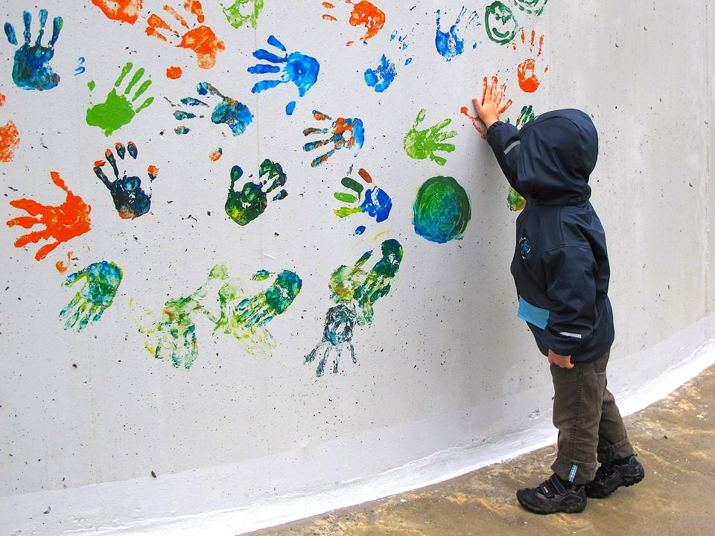
POINTS TO CONSIDER TO HAVE A SUCCESFUL VBS
2. KNOWING YOUR PARTICIPANTS AND WHAT THEIR NEEDS ARE WILL HELP YOU PREPARE BETTER .
Consider conducting a survey to know how many children are interested in your church, and in your community to help you allocate your budget, resources, and materials better.

Slide 5
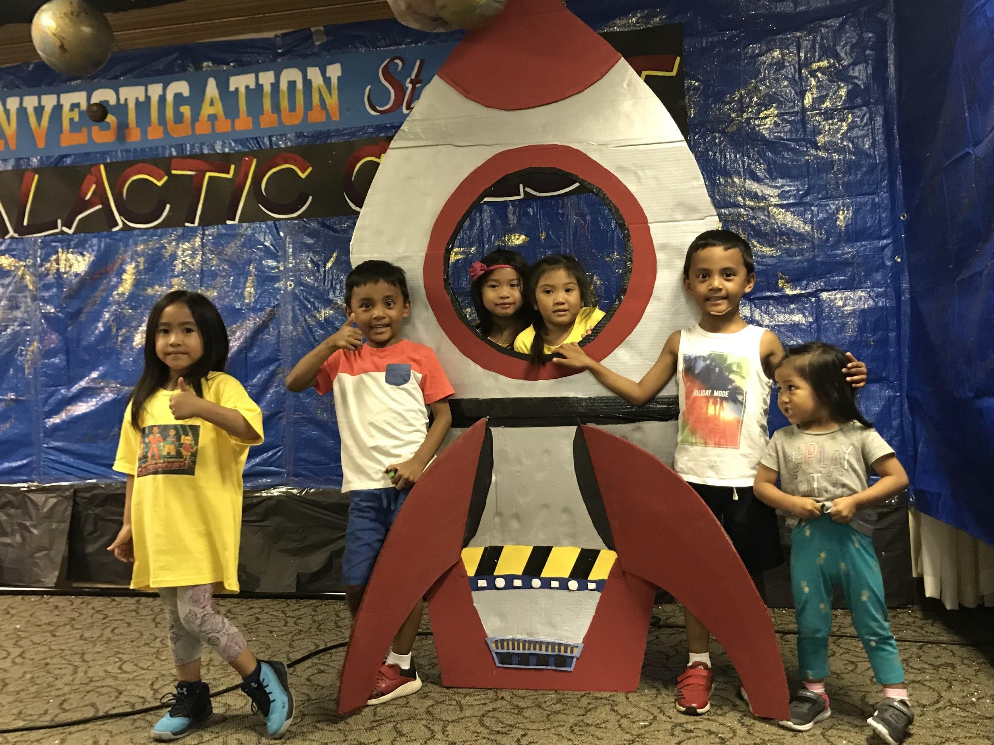
TARGET PARTICIPANTS
1. KINDERGARTEN - GRADE 4
- group the kids by age
- each group should have 5-6
students.
- assign a group leader for each
group
When assigning the group leaders, always keep in mind the two-person rule for the safety of everyone.

Slide 6
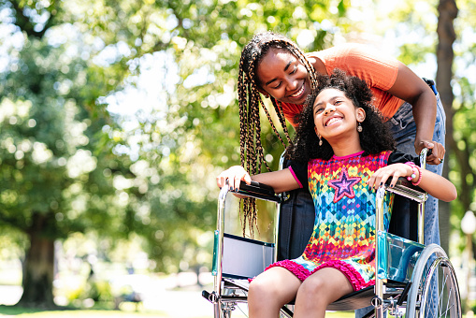
2. CHILDREN WITH SPECIAL NEEDS
a. Have a buddy system. Do a buddy training sessions leading up to VBS.
b. Provide ready-to-go tools (Visual schedules, fidgets, visual timers to
help kids focus).
c. Include in the pre-registration form some specific questions related to
the child’s disability or needed supports. Provide a Special Need Intake
form.
d. Implement proactive ideas ahead of time to help your week of VBS go
more smoothly. Consider Alternative Areas depending on the need of
the child (i.e., if the child is sensitive to heat or sun, provide indoor
activity for the child. If the child is sensitive to loud sound provide
headphone or quieter area).
e. Other proactive ideas:
Include visual prompts for the Key Bible Verses.
Incorporate sign language with the songs.
Prepare a sheet that gives an overview of each day’s focus to help the
child know what to expect.

Slide 7
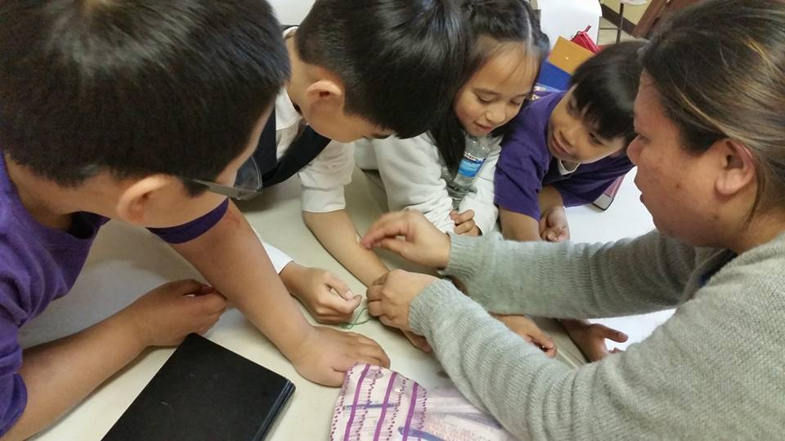
3. PRE-SCHOOLERS
- separate leader
- age-appropriate activities
- separate room
- separate team of craft and refreshment leaders

Slide 8
POINTS TO CONSIDER TO HAVE A SUCCESFUL VBS
3. Have a safe and comfortable location.
Consider using the outdoors for your game station or craft station. Build an open tent, if possible, to avoid direct exposure to the sun. Or set a day in the park where the kids can do the games.

Slide 9
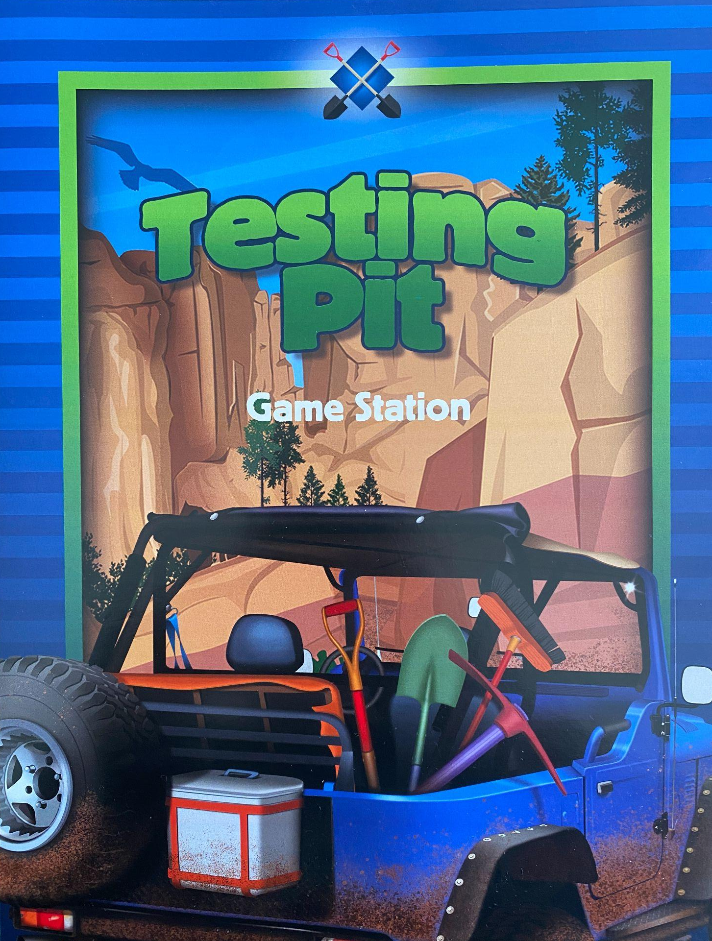
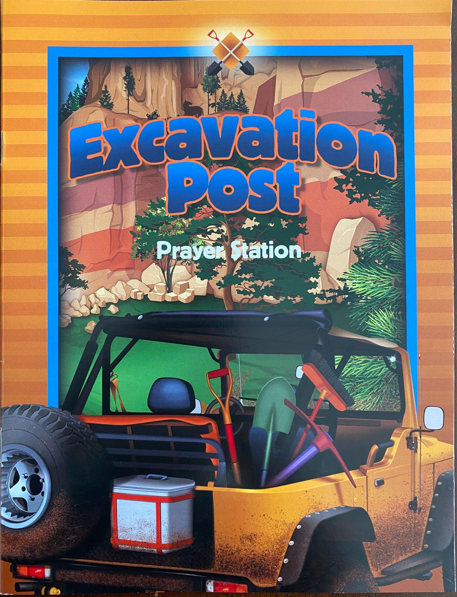
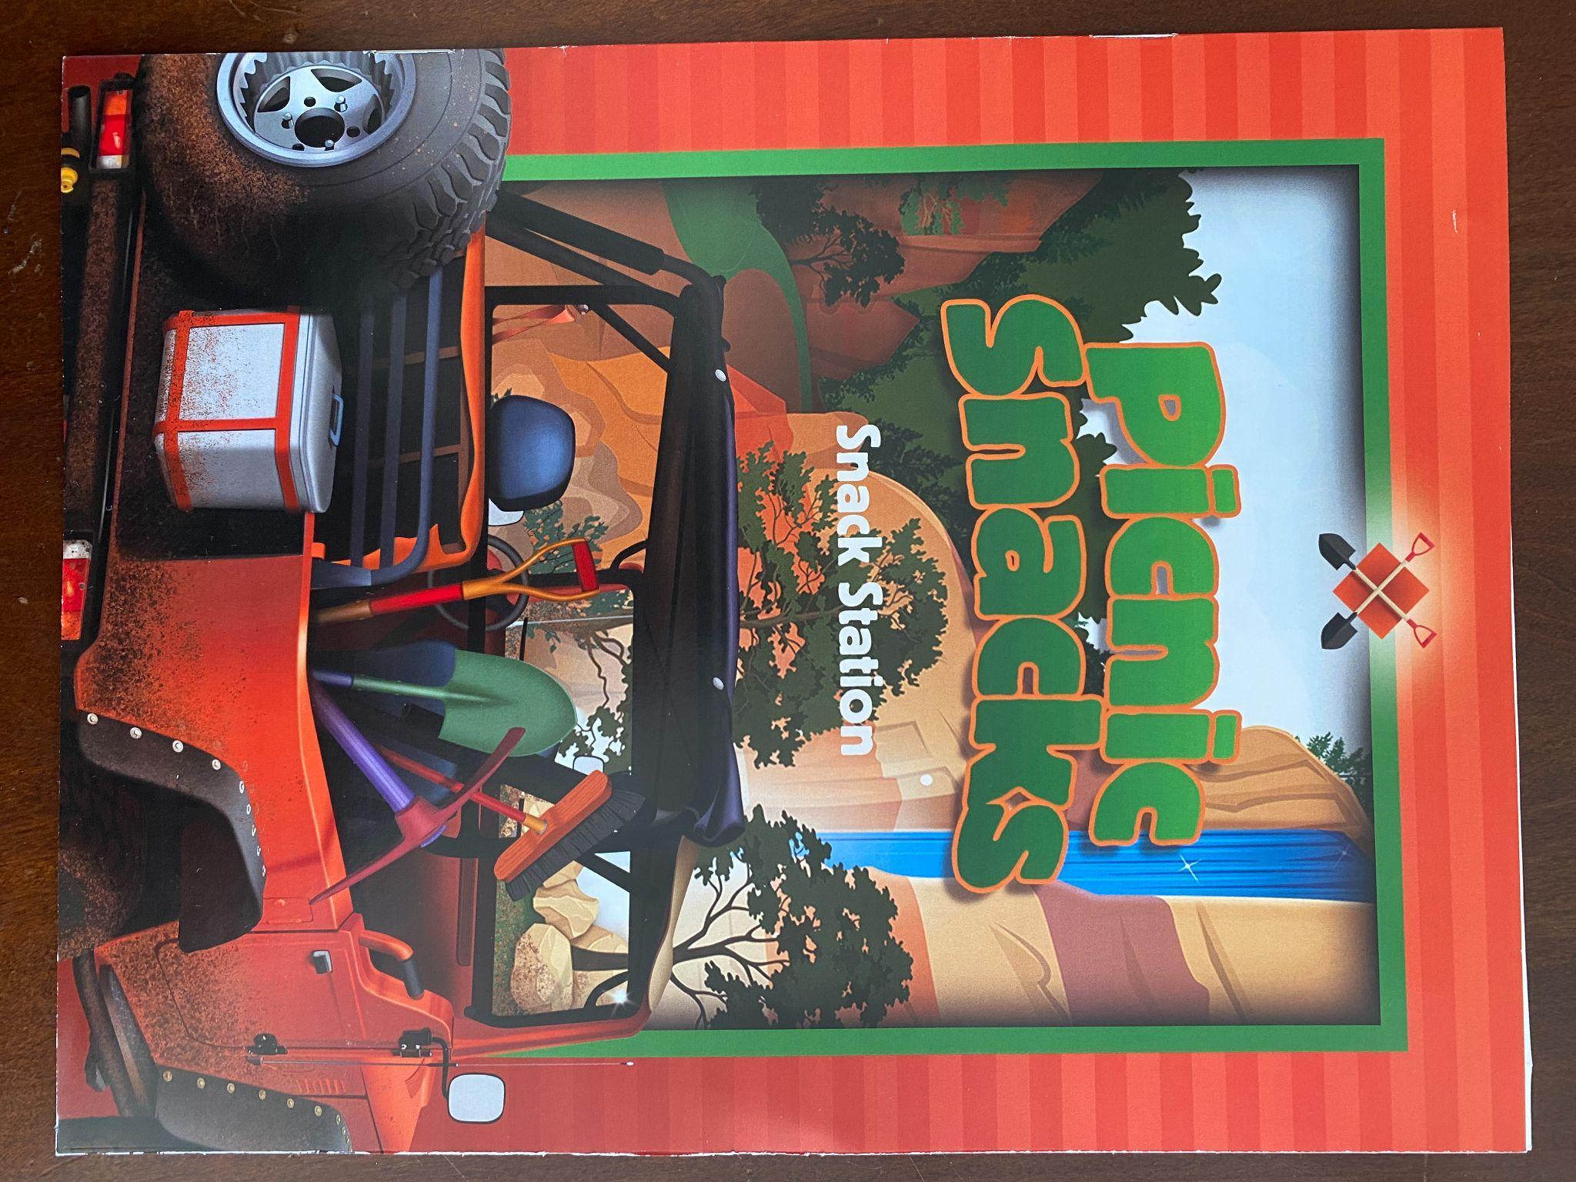
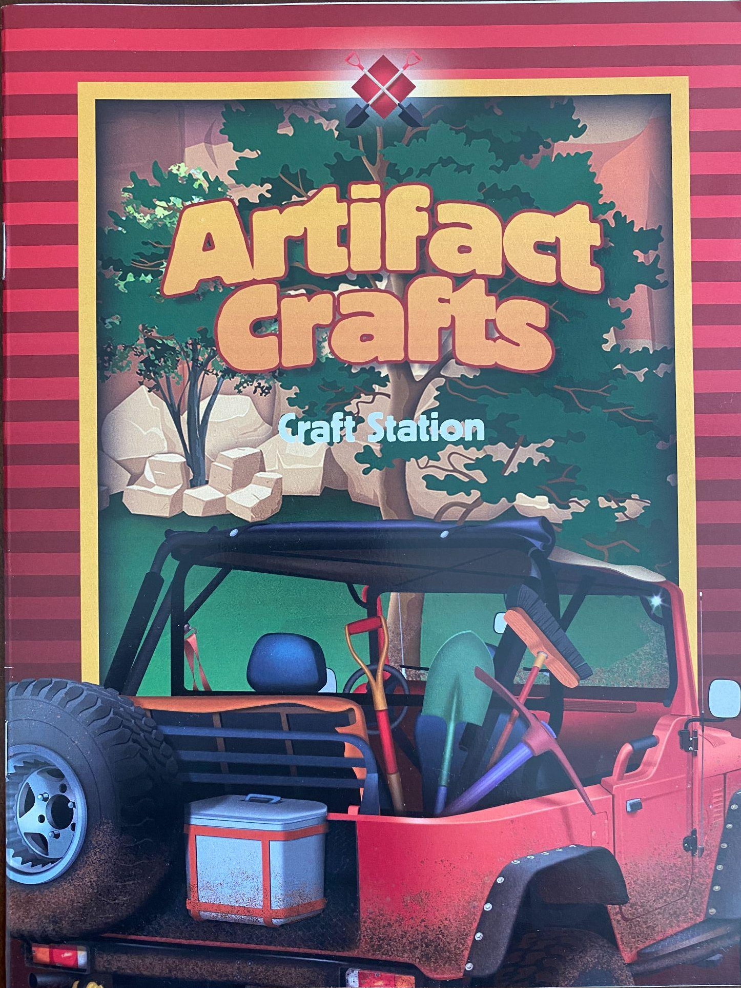
The Stations
There are 5 Stations
Bible Story
Prayer
Craft
Game
Snack
Tip: The bible story station can be done right after the welcome and praise time while the kids are still seated on the mat.

Slide 10
Station Rotations
Picnic Station
20 Minutes
Games Station
20 minutes
Opening 20 minutes
Bible Story Time
20 minutes
Closing
25 minutes
Prayer Station
20 minutes
Crafts Station
20 minutes
Childmin.org

Slide 11
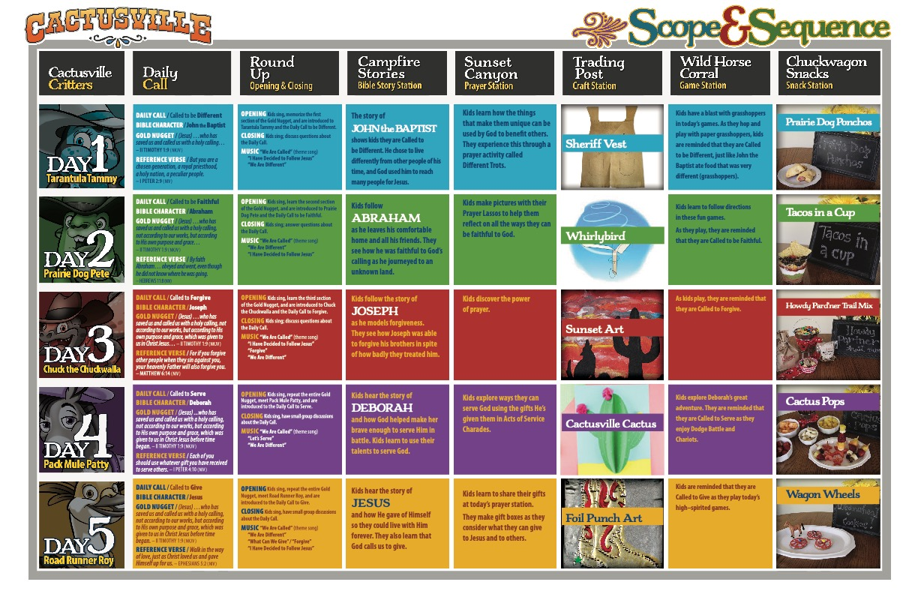
Suggested Schedule
Childmin.org

Slide 12
POINTS TO CONSIDER TO HAVE A SUCCESFUL VBS
4. Have a mixture of young and adult volunteers who can commit to assist the VBS for a week.
Commitment is essential. So, meet with your volunteers ahead of time. Explain what is expected of them and provide the manual for the specific role assigned to them.
This Photo by Unknown Author is licensed under CC BY

Slide 13
VOLUNTEER STAFF
VOLUNTEERS
Group 1
Leader: Tyler D
Assistant Leader: Ian D.
Students: (Age 4-5)
Kyla E.
Marcus C.
Kaylee D.
Registrar/Receptionist
Station Leaders
Musicians
Bible Story Tellers & Actors
VBS Graduation program Coordinator
Art Director
Craft Director
Refreshment Director
Photographer/Videographer
First Aid Crew
Health & Safety Patrol
Station 1 Leader:
Matthew A.
Members:
Jezrel S.
Crystal P.
Childmin.org

Slide 14
VIRTUAL VBS
Childmin.org

Slide 15
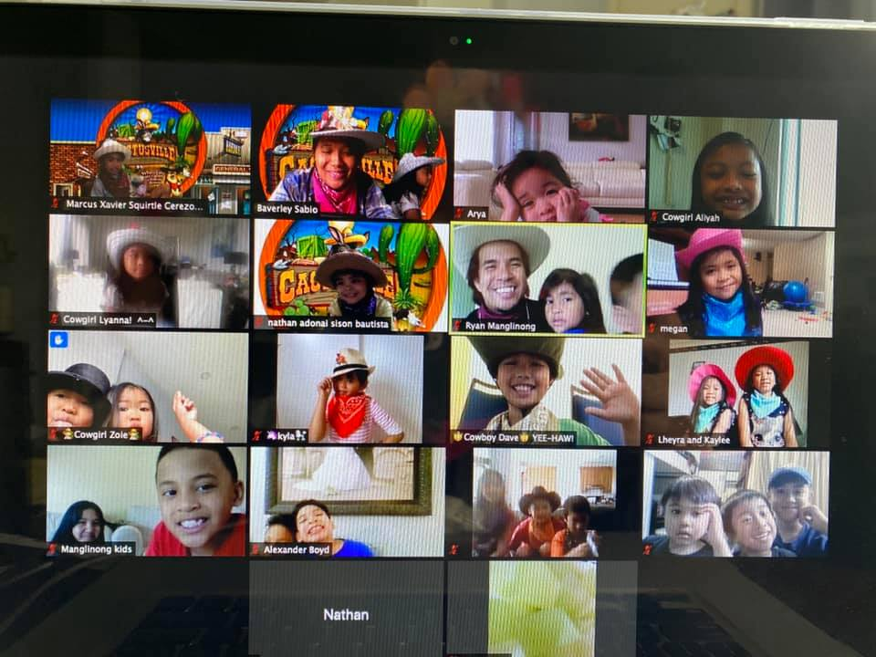
TWO APPROACHES TO VIRTUAL VBS
Produce VBS videos for each day following the sequence of the daily program. Add already made music videos, puppet videos, and other videos that is in the VBS kit that you purchased. To personalized each video, add the hosting in the video. You can also video taped actors from your church to do the bible story time. Modify the script as needed. Post the videos on YouTube or stream it via zoom. The children can watch and do the activities at any time with the parents, or with a group via zoom. You can pause the video when it’s time to do the activities. If using zoom, you need a host to play and pause the video.

Slide 16
TWO APPROACHES TO VIRTUAL VBS
2. Do a live virtual VBS via zoom or google meet for a more interactive VBS. Run the live session for at least 2.5 hrs. each day for the whole week. The Host is live and wears a costume.
What you need:
Purchase a VBS curriculum that is ready for virtual VBS. If the kit is for in-person only, the host needs to modify the script for each day and use any already made Videos included in the kit such as music videos, puppet videos, story videos, etc. and play them following the sequence of the program for each day.
Communicate to the parents/guardians that they need to be with their child when the live session begins to assist and to reinforce what the child is learning on each day.
Have the parents set up the materials for each station activity ahead of time, so the children can get right to it when it’s time to do the activities (i.e., bake the cookies for the snack station early, so that the child will only need to put the decoration).

Slide 17
WHAT TO PREPARE WHEN DOING LIVE VIRTUAL VBS
1. Review the manual for each station first. Check the materials needed for each day on each activity station.
Prepare the materials ahead of time and put all the materials on a string backpack for each participant. Use a nice folder to organize the printed materials.
a. Print any templates needed for arts and crafts.
b. Provide to the parents the snack station recipe and the list of items they need to purchase for the snack
station. Provide also a list of items they need that are not included in the string backpack.
c. Provide art supplies to each participant as much as possible. Consider providing some colored paper, glue,
crayons, stickers, etc. Buy the craft supplies in bulk & as early as possible. Consider shipping time &distribution.
d. Consider labeling the items you provided as to what day they need them.
e. Set up a location, day and time when they can pick up their string backpack/materials.
3. Print the Certificate of Attendance ahead of time and give the certificate the same day they pick up their materials.
Provide instruction to the parents that they will only give the certificate to their child on the day of the Virtual
VBS Graduation ceremony. Keep the parents on the loop as you plan for Virtual ceremony.
4. Create a Facebook group page to allow all participants to post videos and pictures they took for each day. Create
an Album to sort the postings by date.

Slide 18
IN- PERSON & VIRTUAL VBS GRADUATION
The Virtual VBS Graduation can be done on a Sabbath. The program can be partially recorded if using zoom and streaming live at the same time. This type of programming, you will be able to do a live ceremony, where you can put the spotlight to the participant receiving the certificate from the parent.
When giving parts to the children, consider giving out parts as early as possible to avoid late submission of their videos, and to give them enough time to practice and record. Ideal is to have the Virtual Graduation ceremony Two weeks after the VBS. In your video, consider highlighting the best parts of your VBS. Gather all the pictures and videos taken by each participants. Include the parents in the program and give every child a part in the graduation.
For in-person VBS, distribute the parts on the second day of the VBS. Have your VBS Graduation program Coordinator take care of the program. Most of the time, the VBS graduation is done on the last day of the VBS. So, since there’s not much time for practice, consider giving parts in groups. Gather the crafts the children made and let them present it. Include the group leaders when children perform their parts.
See a sample of our live virtual VBS highlighting what we did for the entire week.
Video on the next slide.

Slide 19
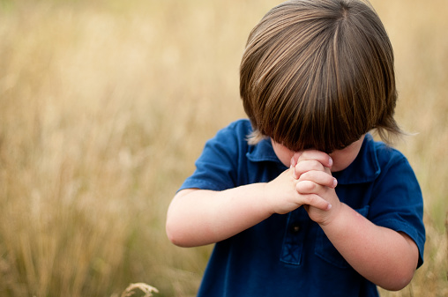
“Commit your works to the Lord, and your thoughts will be established.”
Proverbs 16:3 NKJV

Slide 20
Thank you!
#SayYESToJesus
Childmin.org

