Slide 1
Best Practices for Health at VBS
Maria McClean

Slide 2
Create safe spaces
for children

Slide 3
Reminders
Follow all pandemic protocols
Registration forms must be completed fully
Ideally all volunteers should be certified in First Aid/CPR/AED
A well-stocked First Aid kit and an AED (Automated External Defibrillator) should be on the premises
Have a clear path to all exits
Do not use sharp objects for craft

Slide 4
Reminders
If serving food, pay attention to food safety
Volunteers should become certified as food handlers. For the training manual and certification information in French and English, check this site:
https://www.health.gov.on.ca/fr/pro/programs/publichealth/enviro/docs/training_manual.pdf
https://www.health.gov.on.ca/en/pro/programs/publichealth/enviro/docs/training_manual.pdf

Slide 5
Reminders
Identify children and volunteers
with food sensitivities and allergies

Slide 6
Emergency Numbers
9-1-1
TELEHEALTH ONTARIO - 1-866-797-0000

Slide 7
Anaphylaxis – severe allergic reaction
Symptoms
itching (generalized or specific to the mouth and throat)
swelling of the lips and/or tongue
hoarseness, tightness or closure of the throat, shortness of breath, coughing

Slide 8
Anaphylaxis – Symptoms
difficulty swallowing
hives, redness and swelling of the skin
slurred speech
wheezing, weak pulse
nausea, dizziness, vomiting, diarrhea and cramps

Slide 9
9-1-1
Anaphylaxis is unpredictable and seconds count!! Act fast and call 9-1-1 immediately even after using epinephrine since a second reaction may occur

Slide 10
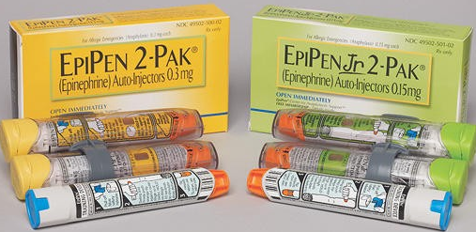
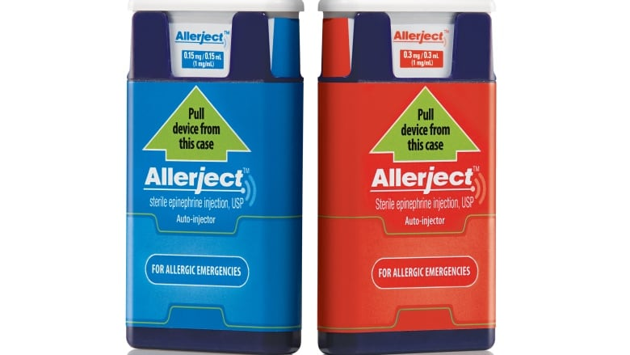
Emergency Treatment - Epinephrine Auto-Injectors

Slide 11
Persons responsible for food preparation should be aware of food and product labels to identify allergens in order to be food safe
Anyone can have an anaphylactic reaction if utensils and equipment used for items to which persons are allergic are not cleaned thoroughly before they are used in other food preparation. Cross-contamination must be avoided!!!

Slide 12
Reminders for Snack Times
Preventing Choking in Toddlers and Preschoolers www.aboutkidshealth.ca
Choking is one of most preventable injuries. It is a leading cause of death in infants and children
Supervise children during all meal and snack times and cut potentially hazardous foods into smaller bite-sized pieces

Slide 13
www.aboutkidshealth.ca
Do not serve snacks on toothpicks or skewers
Slice grapes, hot dogs and sausages lengthwise
Serve carrots, apples, etc. finely chopped or grated

Slide 14
www.aboutkidshealth.ca
Do not let older children feed smaller children unless they are supervised closely
Sit at a table, encourage a relaxed, safe eating environment and instruct children to chew their food well before swallowing

Slide 15
www.aboutkidshealth.ca
Discourage walking or running while eating
Take care to remove any unsafe food or toys from children's reach
Avoid using latex balloons. Use shiny foil or Mylar balloons instead

Slide 16
Miscellaneous
Instruct volunteers who are ill to stay at home
Observe children for symptoms of flu or other illnesses. Isolate them, if necessary, with supervision and contact the parents/guardians asap to take them home
Do not administer non-prescription medication. (This does not include emergency cases like severe allergic reactions/anaphylaxis that require immediate medical attention)

Slide 17
Do not use alcohol, hydrogen peroxide on cuts and bruises. These destroy tissue and delay healing
Do not use antibiotic creams on minor cuts and bruises. Children may be allergic to them
Review treatment for falls, head injury, concussion, seizures, etc. (See resources ** )
Keep children hydrated (preferably with water)

Slide 18
Miscellaneous Display this contact information in a prominent location
Ontario Poison Centre - Open 24 hours
1-800-268-9017 OR 416-813-5900

Slide 19
Resources**
https://www.aboutkidshealth.ca
https://www.health.gov.on.ca/en/pro/programs/publichealth/enviro/docs/training_manual.pdf
https://www.canada.ca/en/public-health.html
https://www.redcross.ca/
https://www.sja.ca/en
https://www.heartandstroke.ca/
www.phac-aspc.gc.ca.
www.adventistontario.org (Health Ministries)

