Slide 1


How to conduct a Vacation
Bible School
by Denisa Zita
March 5, 2023
Notes:
Before we start –rename yourself –First name, shortcut of Church presented,
-more info in the VBS Quickguide booklet you can get from AdventSource.
What defines a successful VBS? – no injuries, lots of kids, families coming to your church, Kids giving their hearts to Jesus, seeds planted.
Outreach – when community actually comes to your church. I will present from that perspective since our church gets a lot of community kids joining our VBS.

Slide 2
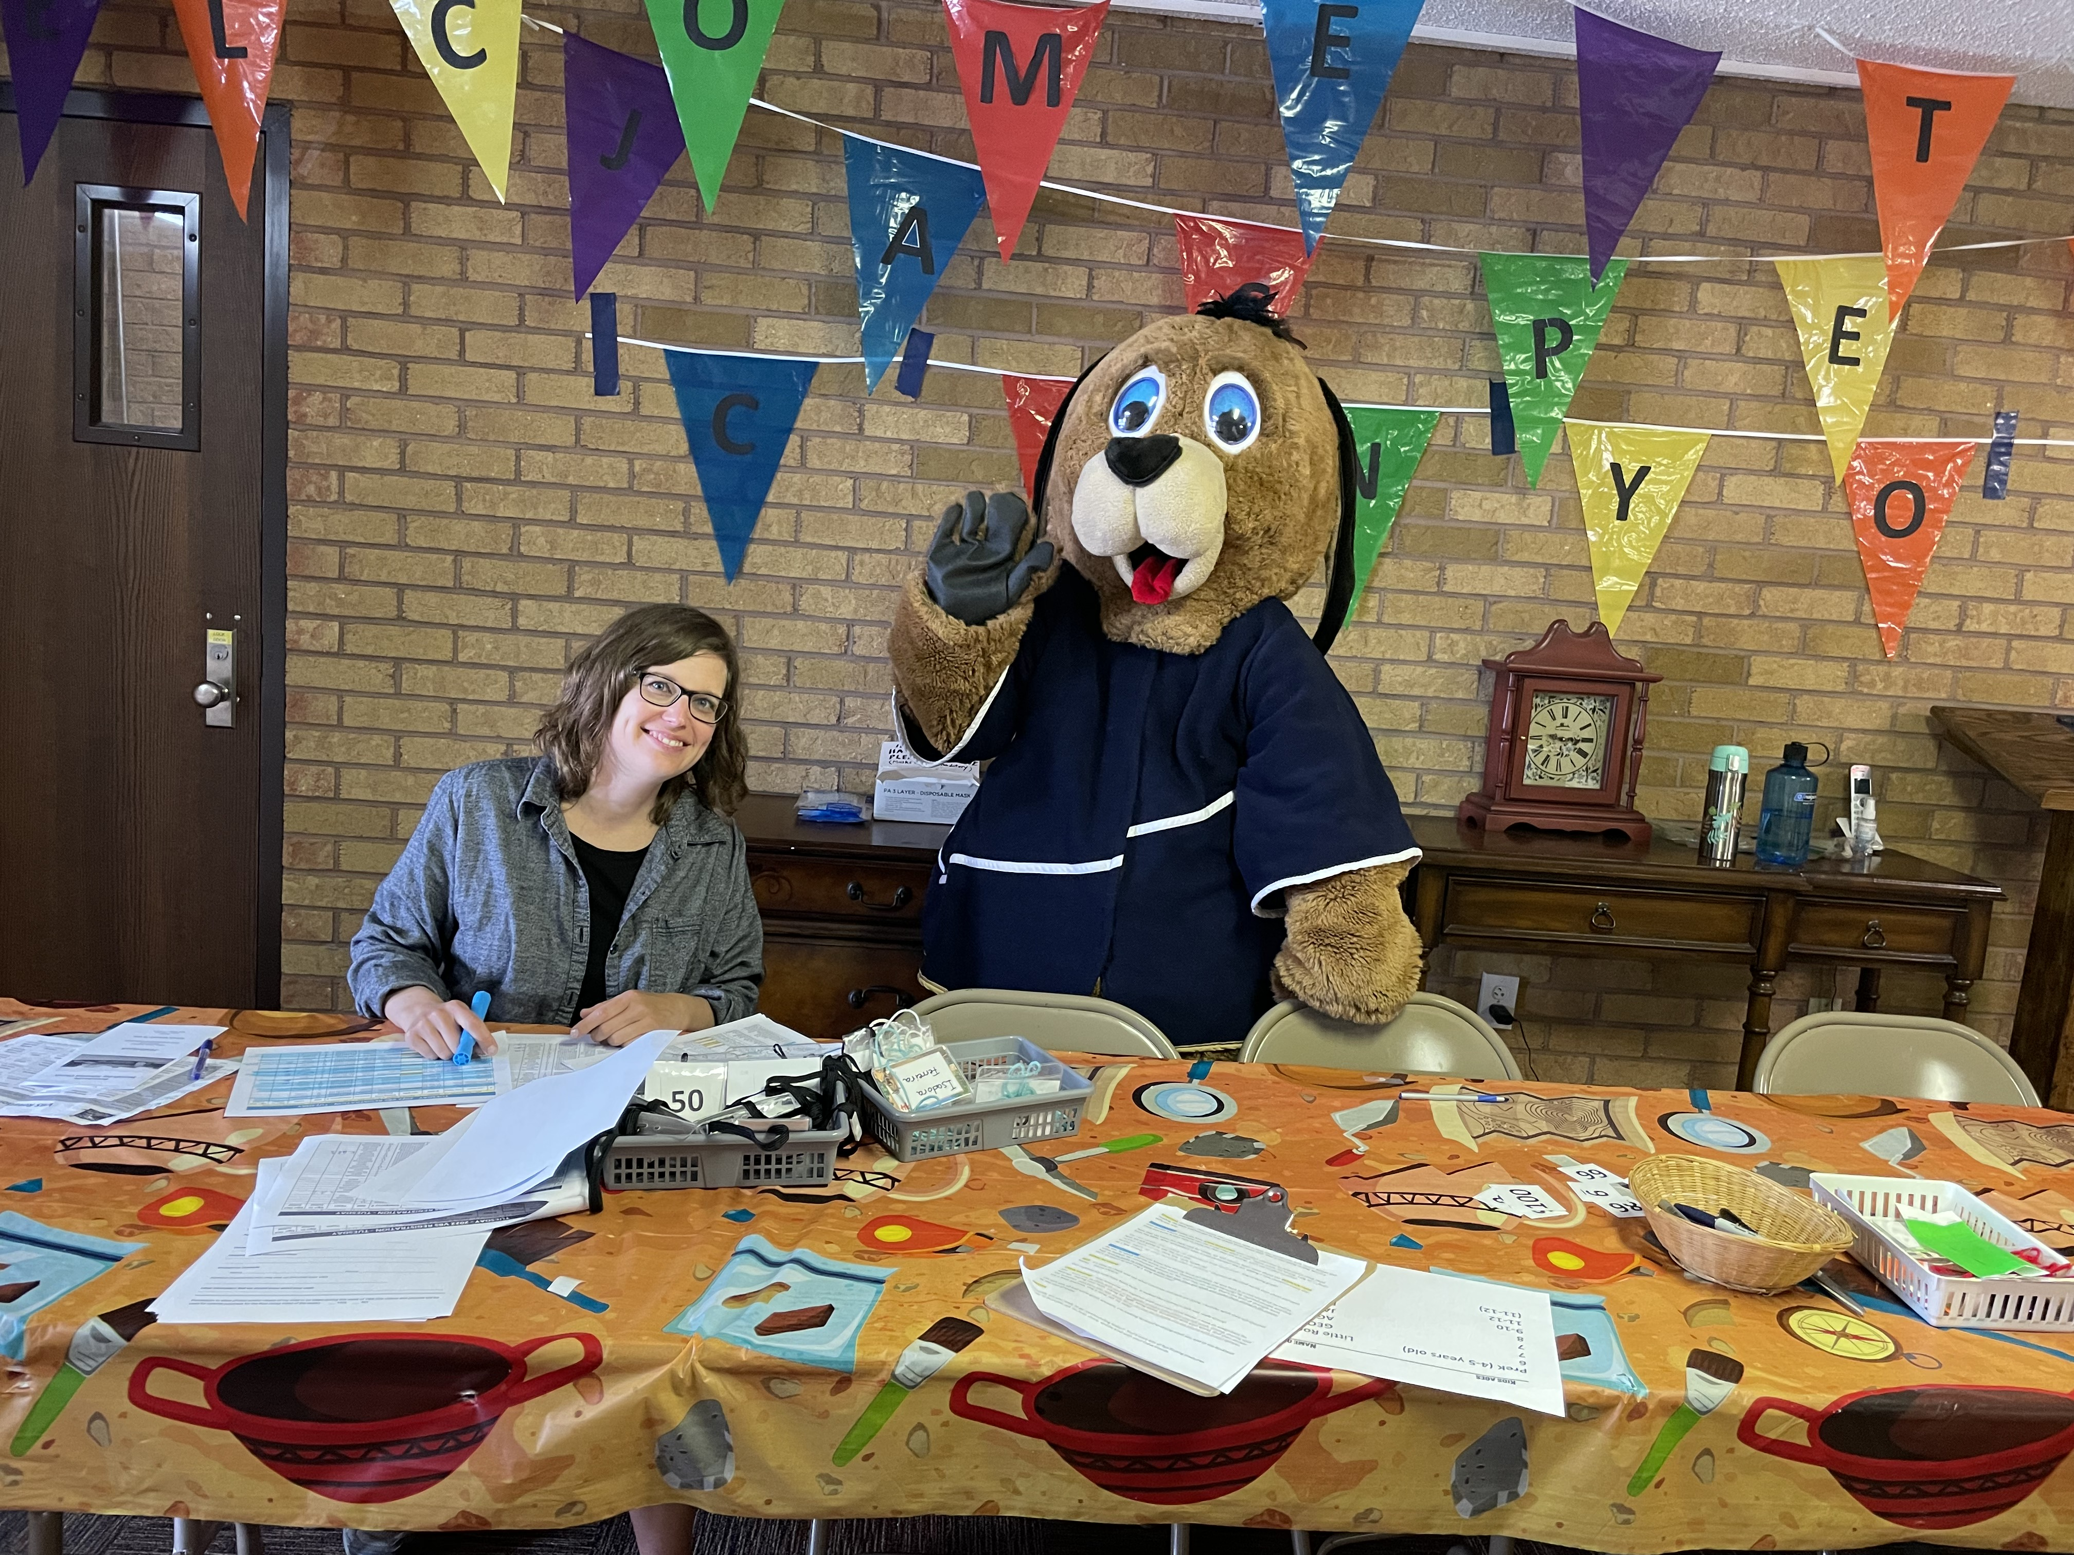
1 day before VBS starts
・Decorate the hallway and the front of the Sanctuary/hall where all kids meet
・Download pre-registration forms to get final count of kids (print Sign-up sheets)
・Email parents to arrive early on first day to sign-in their kids
・Message your leaders and staff with last minute details
Notes:
*Start early -10am, because it always takes longer than expected.*
Have a printout of all preregistered kids so the check in will be smoother. Make name tags for each, including special wristbands for those with allergies or special needs. Print Sign-up sheet for those arriving on the spot. Make sure that on the website or on the forms you have a section where you get permission from parents to post images or videos of their kids. Use jotform to do online registration, google docs. (our church uses church’s website to sign in - I see all names come in).*
send email to parents to remind them to come early the next day, since it will take longer to Sign In everyone.*
send messages to Staff with last minute details, and to let them know that you are praying for them.

Slide 3
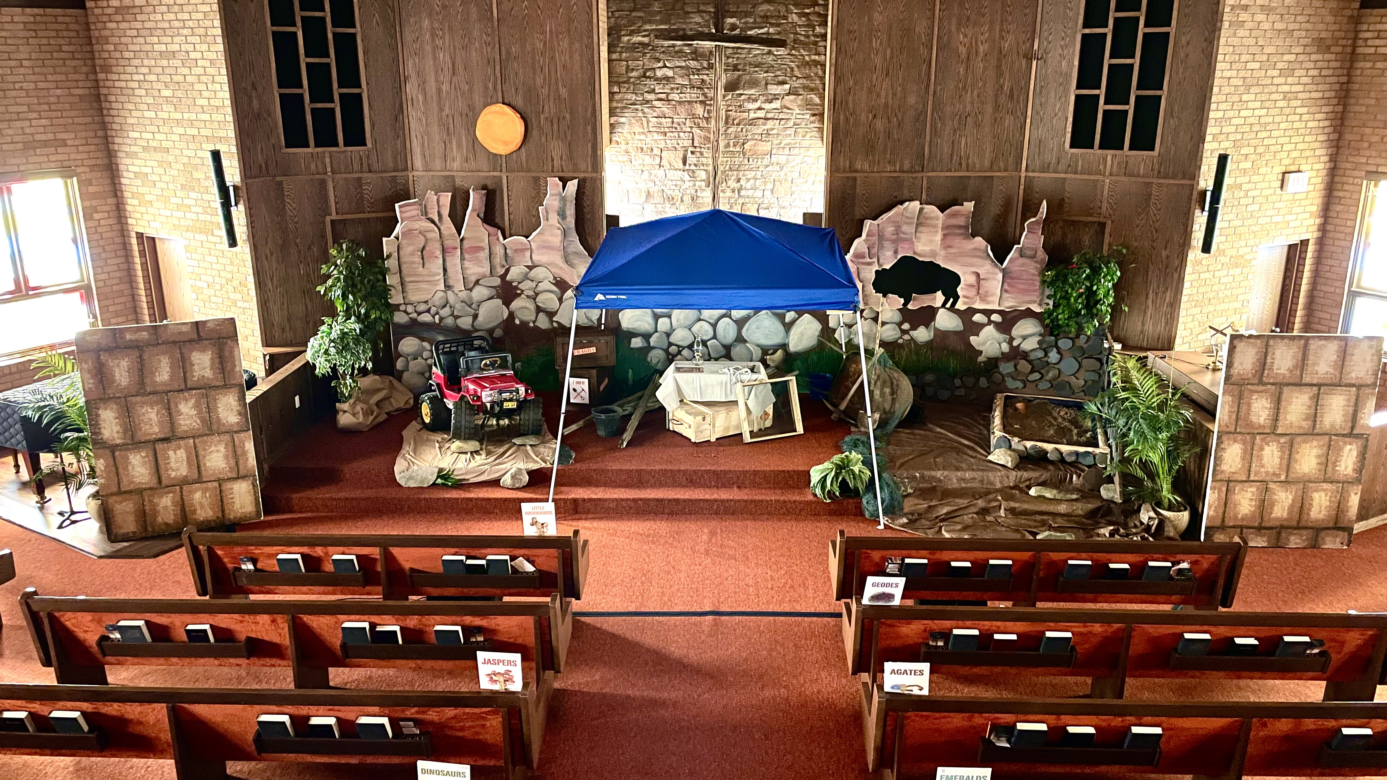
During the week of VBS
・Have an assistant to help and share responsibilities
・Designate a photographer/videographer
・Jot down daily quick notes of thoughts and improvements for next year.
・PRAY for God’s leading throughout the day
・Be well rested!
・Pace yourself!
Notes:
The director’s work is to oversee all the activities and deal with emergencies during the week. If the preparation work was done well during the previous 3-5 months before VBS starts, the Director’s work will be easier during the week of VBS. *
1. Have an assistant to help with little things around (communicate info to other leaders, run to the store, help a kid who needs some comfort..etc.)*
2. Designate a photographer/videographer to be in charge with getting footage for your final video to show to the parents/church.*
3. Jot down daily quick notes of thoughts and improvements for next year. Don’t wait for the end of the week, since you might forget details.*
4. Pray for guidance in the decisions that need to be made. And for protection for the kids, for the Holy Spirit to touch hearts, and maybe even for weather.- Keep in touch with the PRAYER team and send regular prayer requests*
5. Be well rested! Any ideas why it is important to be rested that week? (answers) –to make wise choices, decisions under stress, be a good example, sets the mode for the rest of the staff *
6. It will be a very Busy week for the Director, so pace yourself. Do not leave things to be done from day to day, try to have as much done the week before.*
Make sure you have extra volunteers on site -deacon (garbage), someone to love younger kids, run to the store, fix if something broken, deal with injuries*

Slide 4
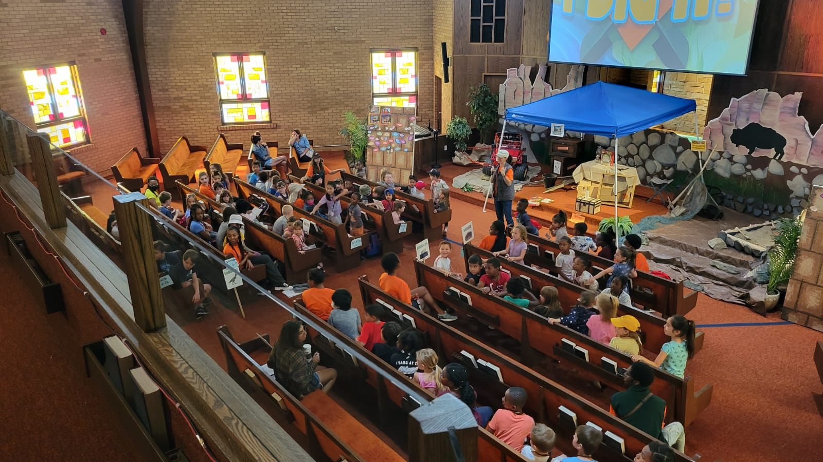
First day of VBS
・Have all volunteers be at church early for last minute details
・Designate a PRAYER leader to gather staff daily for prayer
・Make sure the AV system works (mics and screen)
・Have extra teens to assist with Registration Sign-in and guiding kids to the Assembly Room
・Start on time!
・First day impression matters!
Notes:
be at church the earliest the better. 1. All staff members are encouraged to be there early for last minute set up and group prayer. *
2. Designate someone to be the prayer coordinator and gather volunteers to pray by 8:30am (if your VBS starts by 9am)
If you have a daily Devotional thought to share with the Volunteers, please send it to them each day .*
Check with Station leaders, AudioVisual person and Assembly leader to make sure things are ready to roll. Especially Microphones and screen for videos. Day 1 determines how kids will see the program and if they want to come back. *
REGISTRATION: some Kids will arrive before 9am. Have extra sign in volunteers and teens to help with guiding kids to their seats in the Assembly room. Don’t stress, be kind at the registration table, even people need to wait in line. It’s preferred you have a few lines open for Sign-in for the kids to get their name tags.
Each day make sure all workers are present or that substitutes have been enlisted.*
Start on time!*
First day impression matters! Kid will want to bring their friends for the next day.*

Slide 5





How does the program work?
CRAFTS
station
BIBLE
station
SCIENCE /
PRAYER
station
20- 25 minutes each station with 5 minutes transition time
Opening
Assembly
Closing
Assembly
everyone
everyone
(20-25 minutes)
(10-15 minutes)
SNACKS
station
GAMES
station
Pre-K
Kindergarten
4-5 year olds
Notes:
So, how doe the VBS program go? This is a typical flow. There is an opening and closing program, with 5 stations in between. It’s up to you how long you want each station to be, but we found that 25 minutes is better than 20 minutes. This means that our VBS goes for over 3 hours. (explain the rotation) . *

Slide 6
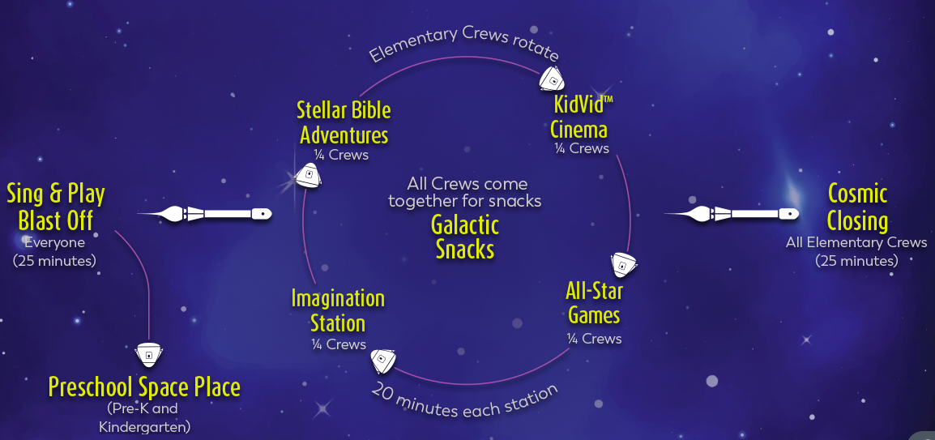
Rotation with joined Snacks time
Notes:
This is a sample of a VBS that doesn’t do the SNACKS station separately, but as a one time thing, sometimes half way through the program. All kids gather together for a 15 minutes snack and then they go back through the stations. The difference with this option, is that there will be more kids in each station at a certain time.

Slide 7
Rotation schedule
New employees & anniversaries
Notes:
ROTATION Stations –This was our last year’s JASPER Canyon’s rotation schedule that each Team leader had. Also, email the Team Leaders the schedule so they know what comes next. make sure there are signs near the door where the station will take place. Designate a route on how to get from station to station. Give 5 minutes change time.
-we divided by ages, but you can have a mix of ages in each Team.*

Slide 8
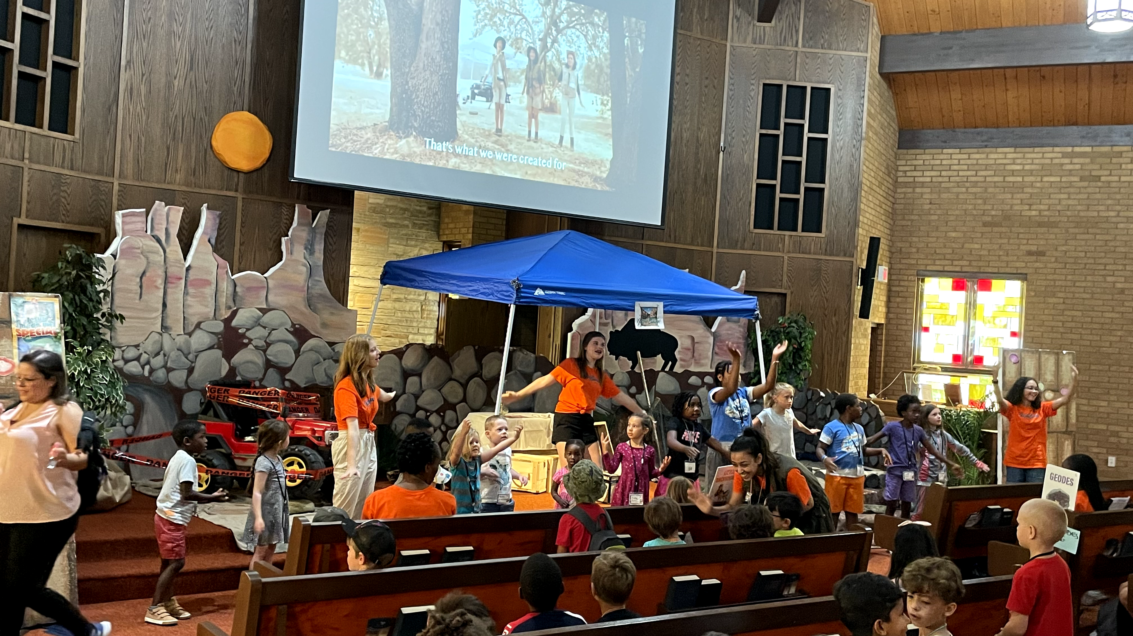
Opening & closing Assembly
・is where all kids meet to start and end the day, usually in the Sanctuary or a big hall (or even outdoors).
・Kids sit with their CREW /TEAM Leaders in designated places
・SONG Leader –involve youth to lead songs on the screen
・Use your own LIVE songs with lyrics on screen
Notes:
ASSEMBLY –Main decoration set located
*this is where all kids meet to start the day, usually in the sanctuary or a big hall. Outdoors under a big tent is another good option, just have a plan B for if it rains. Sometimes you can do VBS in a park.*
The Assembly leader should be an up beat person, charismatic, who gets kids attention. 20-25 minutes . – depending on your church and amount of volunteers -preferably the Assembly Leader is not the director.*
*Team Leaders ready to welcome kids and get to know them -usually 6-8 kids per team. (bigger teams, have teen assistants). Kids sit with the same Team Leaders every day, and they get to know each other. Have Team locations well defined.
Use Youth to help with being team leaders.
have some songs play in the background while kids arrive.*
*SONG leader – if the songs are on screen -involve youth to help lead and do the motions. Ask kids to come up front
If you prefer to do your own songs, have words/track on screen or LIVE and have a good singer/adult or youth lead.
Don’t let the songs of a VBS kit be the determining factor of you choosing the kit or not. You can always adjust the songs to fit your preference. For most kids, songs don’t matter as much as the rest of the program.
(Jasper Canyon –Excellent songs, can be adjusted)*

Slide 9
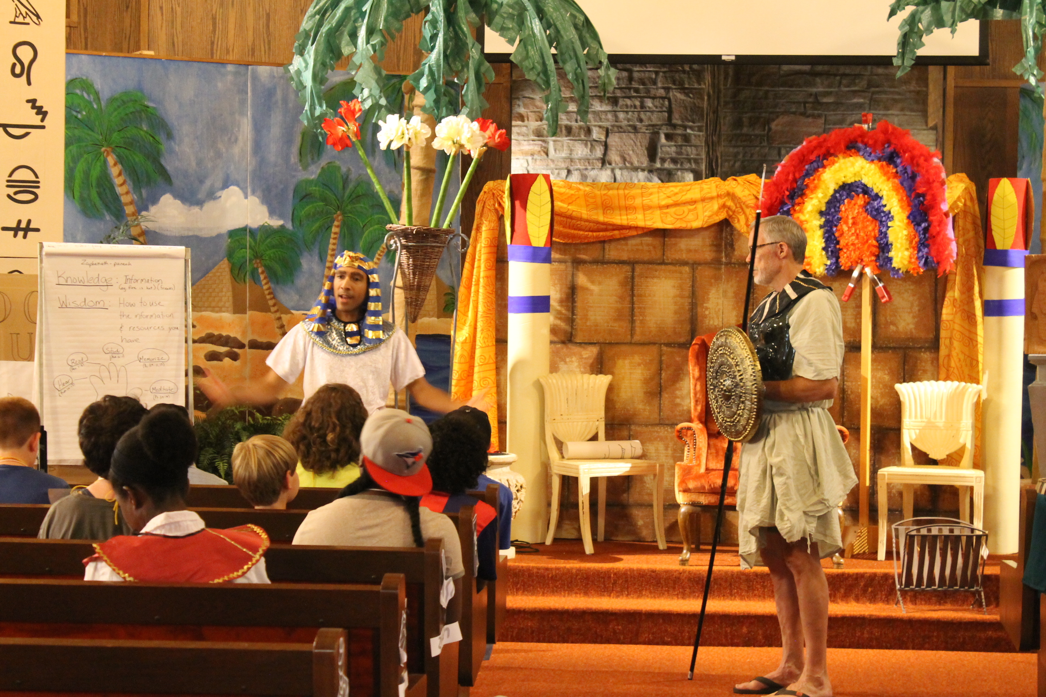
Opening & closing Assembly
・ASSEMBLY Leader – introduces theme of the day, Bible verses, Mission project, prizes, does closing announcements
・Involve kids in discovering the message for the day
・SKIT –LIVE done by youth OR use the provided DVD
・MISSION project – use at the end of Closing Assembly
・PRIZES – for completing challenges, learning Memory verses, behaviour, etc.
Notes:
-INTRODUCE the theme for the week, and for the day, the Memory verse - be creative, *
*INVOLVE kids to come up front and discover hints or clues that leads them into the theme.*
*Skit
*Mission project – explain it on the first day, so kids can bring money to contribute*
*PRIZES or incentives to encourage kids to participate and aim high.*

Slide 10
How does the program work?
CRAFTS
station
BIBLE
station
SCIENCE /
PRAYER
station
20- 25 minutes each station with 5 minutes transition time
Opening
Assembly
Closing
Assembly
everyone
everyone
(20-25 minutes)
(10-15 minutes)
SNACKS
station
GAMES
station
Pre-K
Kindergarten
4-5 year olds
Notes:
After the Assembly, kids divide in groups (already designated) and go from station to station. The Preschoolers go to a separate area for activities *

Slide 11
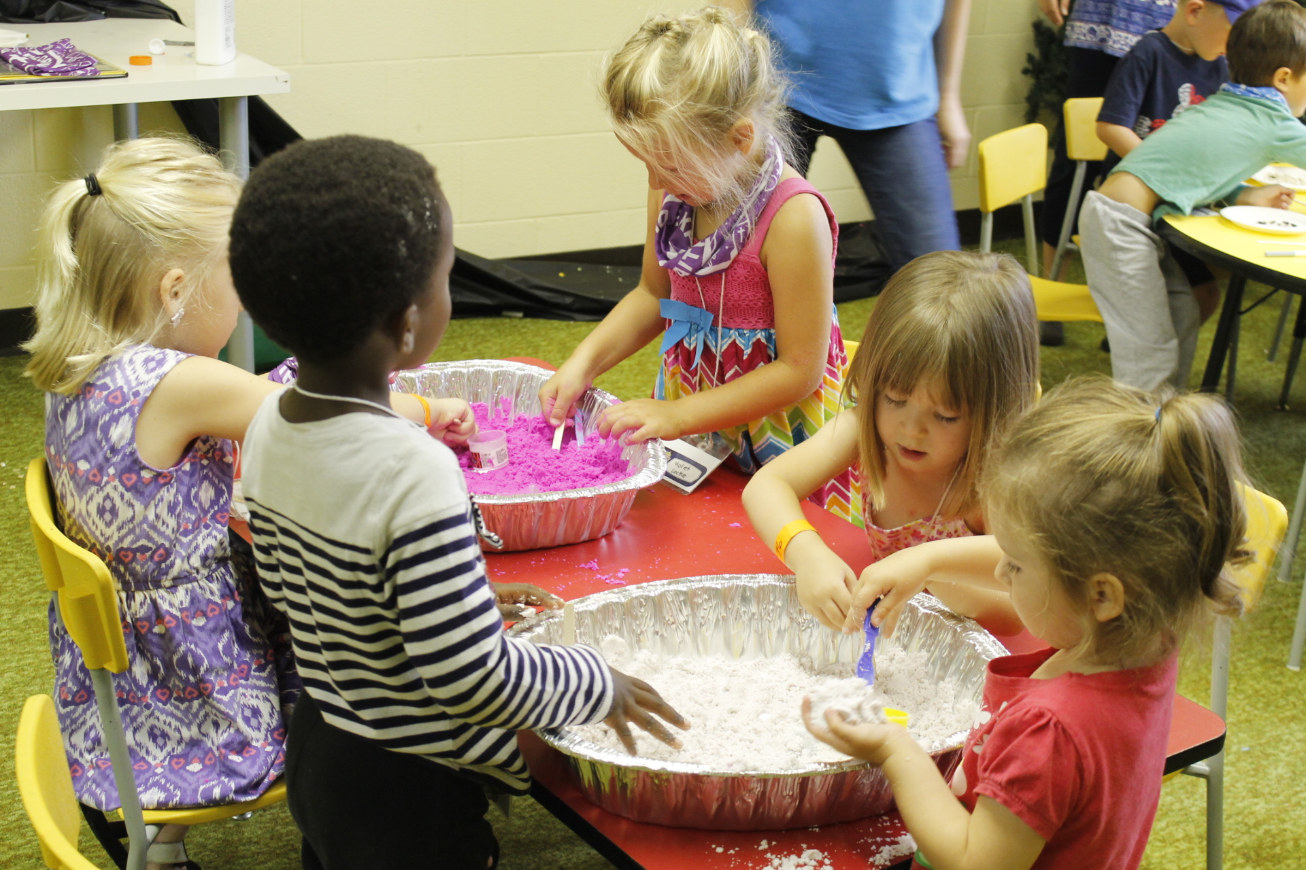
PRESCHOOLERS station (4-5 year olds)
・Separate program, where they do their own games, Bible story and activities, snacks, crafts
・Have enough volunteers for every 5-6 kids or even less
・If possible, split the kids in 2 rooms for different stations
・Invite a Grandma or parent to assist with needy kids.
Notes:
PRESCHOOLERS – *1. separate program after Assembly -do their own games, Bible story, crafts, activities. Split in smaller groups, two rooms/outdoors. *
2. Enough volunteers for each 5-6 kids (some will need bathroom time, others need extra help with crafts, so extra volunteers are always welcome)*
*If possible, split the kids in 2 rooms for different stations - it will be easier to manage. Less noise. And then they rotate.*
*Invite a Grandma or parent to assist. – there will be kids who need extra attention, or bathroom breaks, or just need to be cuddled for a bit. So, extra staff is needed.

Slide 12
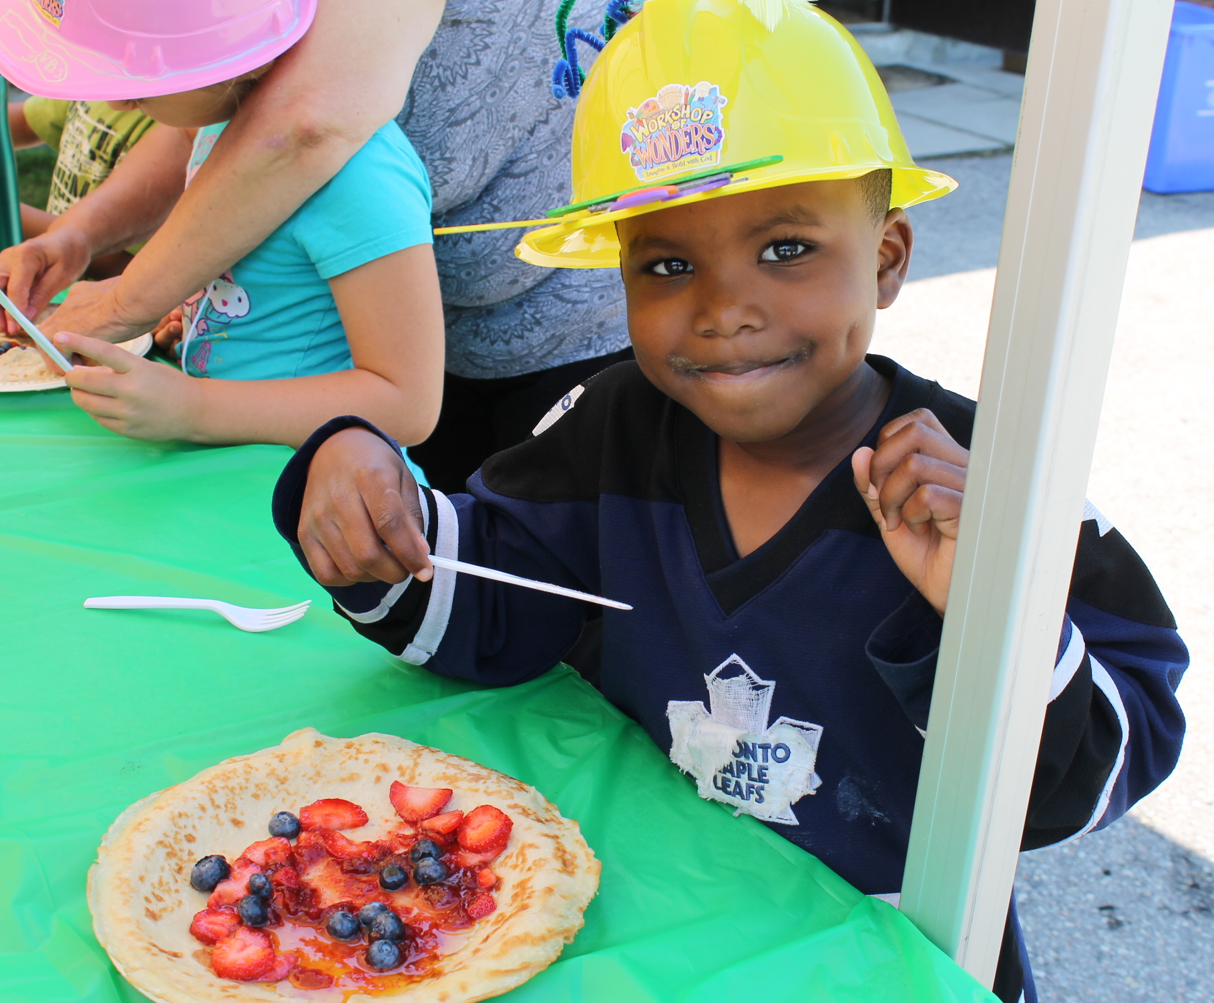
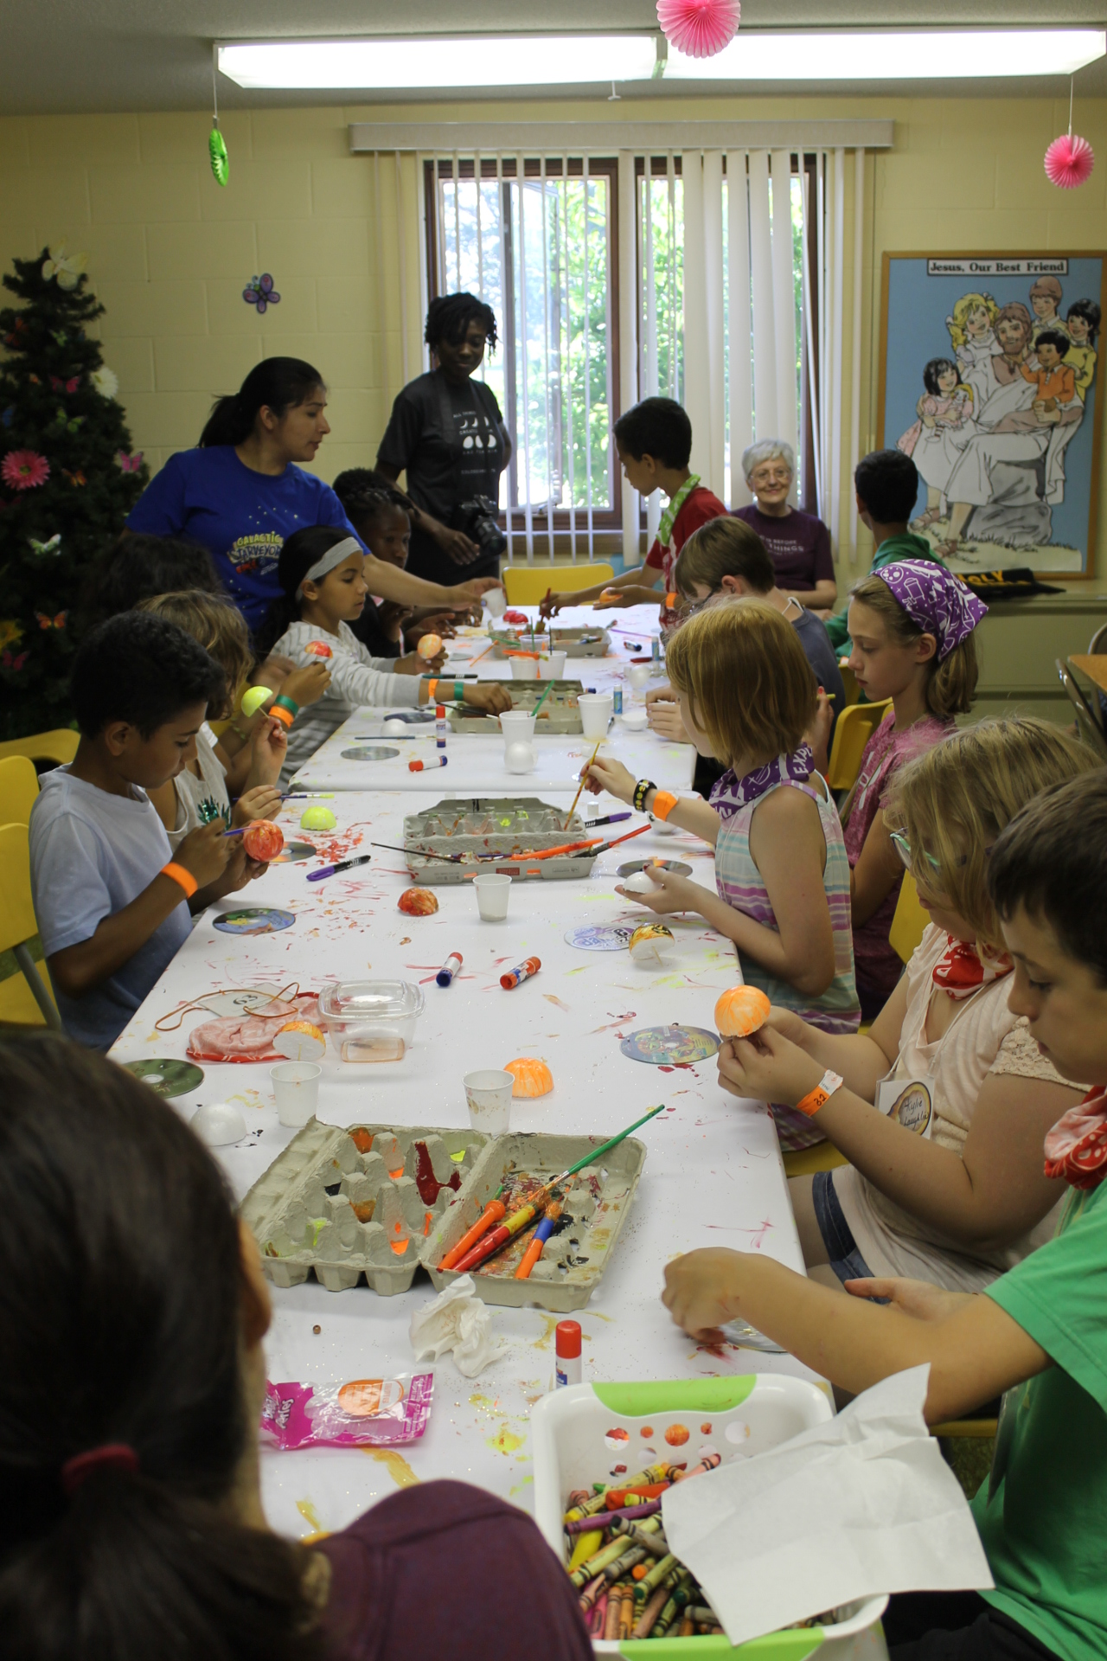
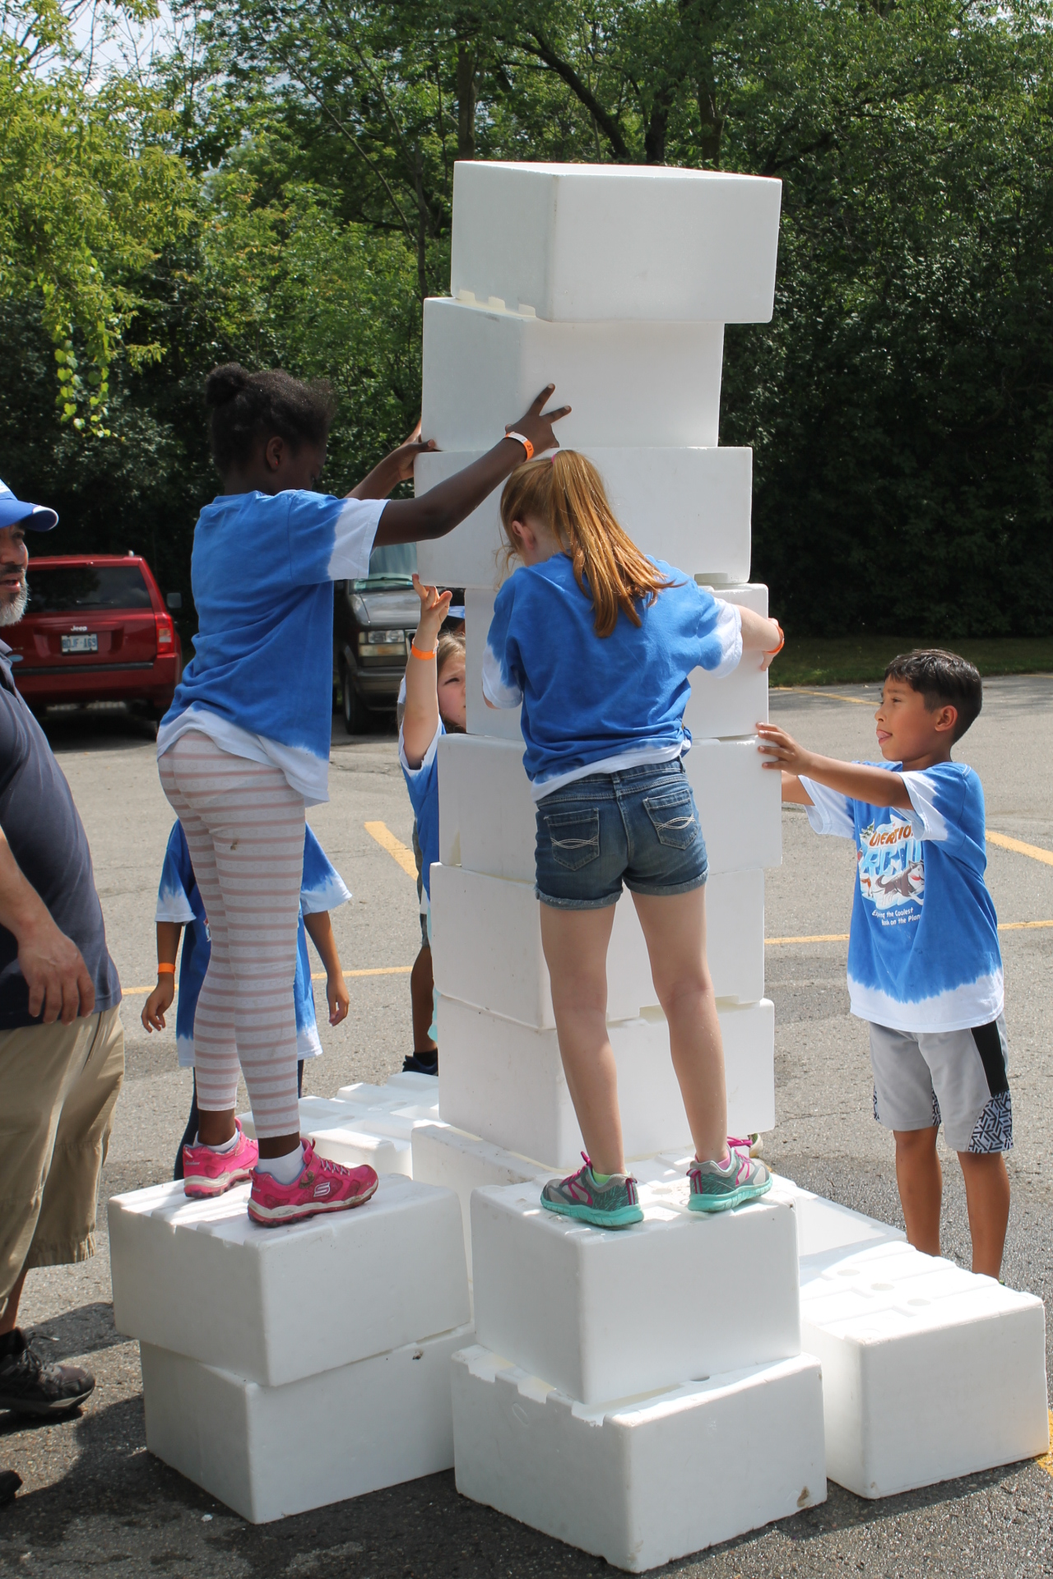
SNACKS, CRAFTS & GAMES
・Outdoor, age appropriate
・Adjust the crafts to be age appropriate
・Keep it simple, healthy, nut free, to reflect our Health message
・Alternate between active and more passive games
Notes:
SNACKS –outdoors if possible to give the kids fresh air. Keep it simple yet have enough (up to you if you want for kids to serve themselves from a tray, or want to pre-made them for them)
- or, if you choose the joined snacks time in the middle of the morning – enlist extra volunteers to help out.. Keep it nuts free!!. Encourage the health message, less sugar, so the kids can focus in their next station. If finish early, show a video, or play game, or review Bible point. *
CARFTS: The materials suggest crafts you can use, but make sure they are age appropriate.(a 6 year old will take longer to make something than a 10 year old, so you might want to simplify or change the craft altogether for the younger kids). Ask for extra volunteer help during that time. Also, the Team Leaders can help.
- Look for at least a craft that they can keep for a long time, or that can be used at home. (will keep the VBS memory going).*
*GAMES – outdoor, age appropriate*
*Have an active and then a more passive one, to include all kinds of kids.
Have water station right after.
Take a minute to bring out the spiritual application of the message for the day.
Have plan B for rainy days –have some space inside for adjusted games. Very few times we had to do games inside. God answered our prayers to hold the rain back, so many times!*

Slide 13
How does the program work?
CRAFTS
station
BIBLE
station
SCIENCE /
PRAYER
station
20- 25 minutes each station with 5 minutes transition time
Opening
Assembly
Closing
Assembly
everyone
everyone
(20-25 minutes)
(10-15 minutes)
SNACKS
station
GAMES
station
Pre-K
Kindergarten
4-5 year olds
Notes:
Now they have gone through Crafts, Games, Snacks station, the most active and fun stations. Let’s look at the last 2 stations, which are also most important.

Slide 14
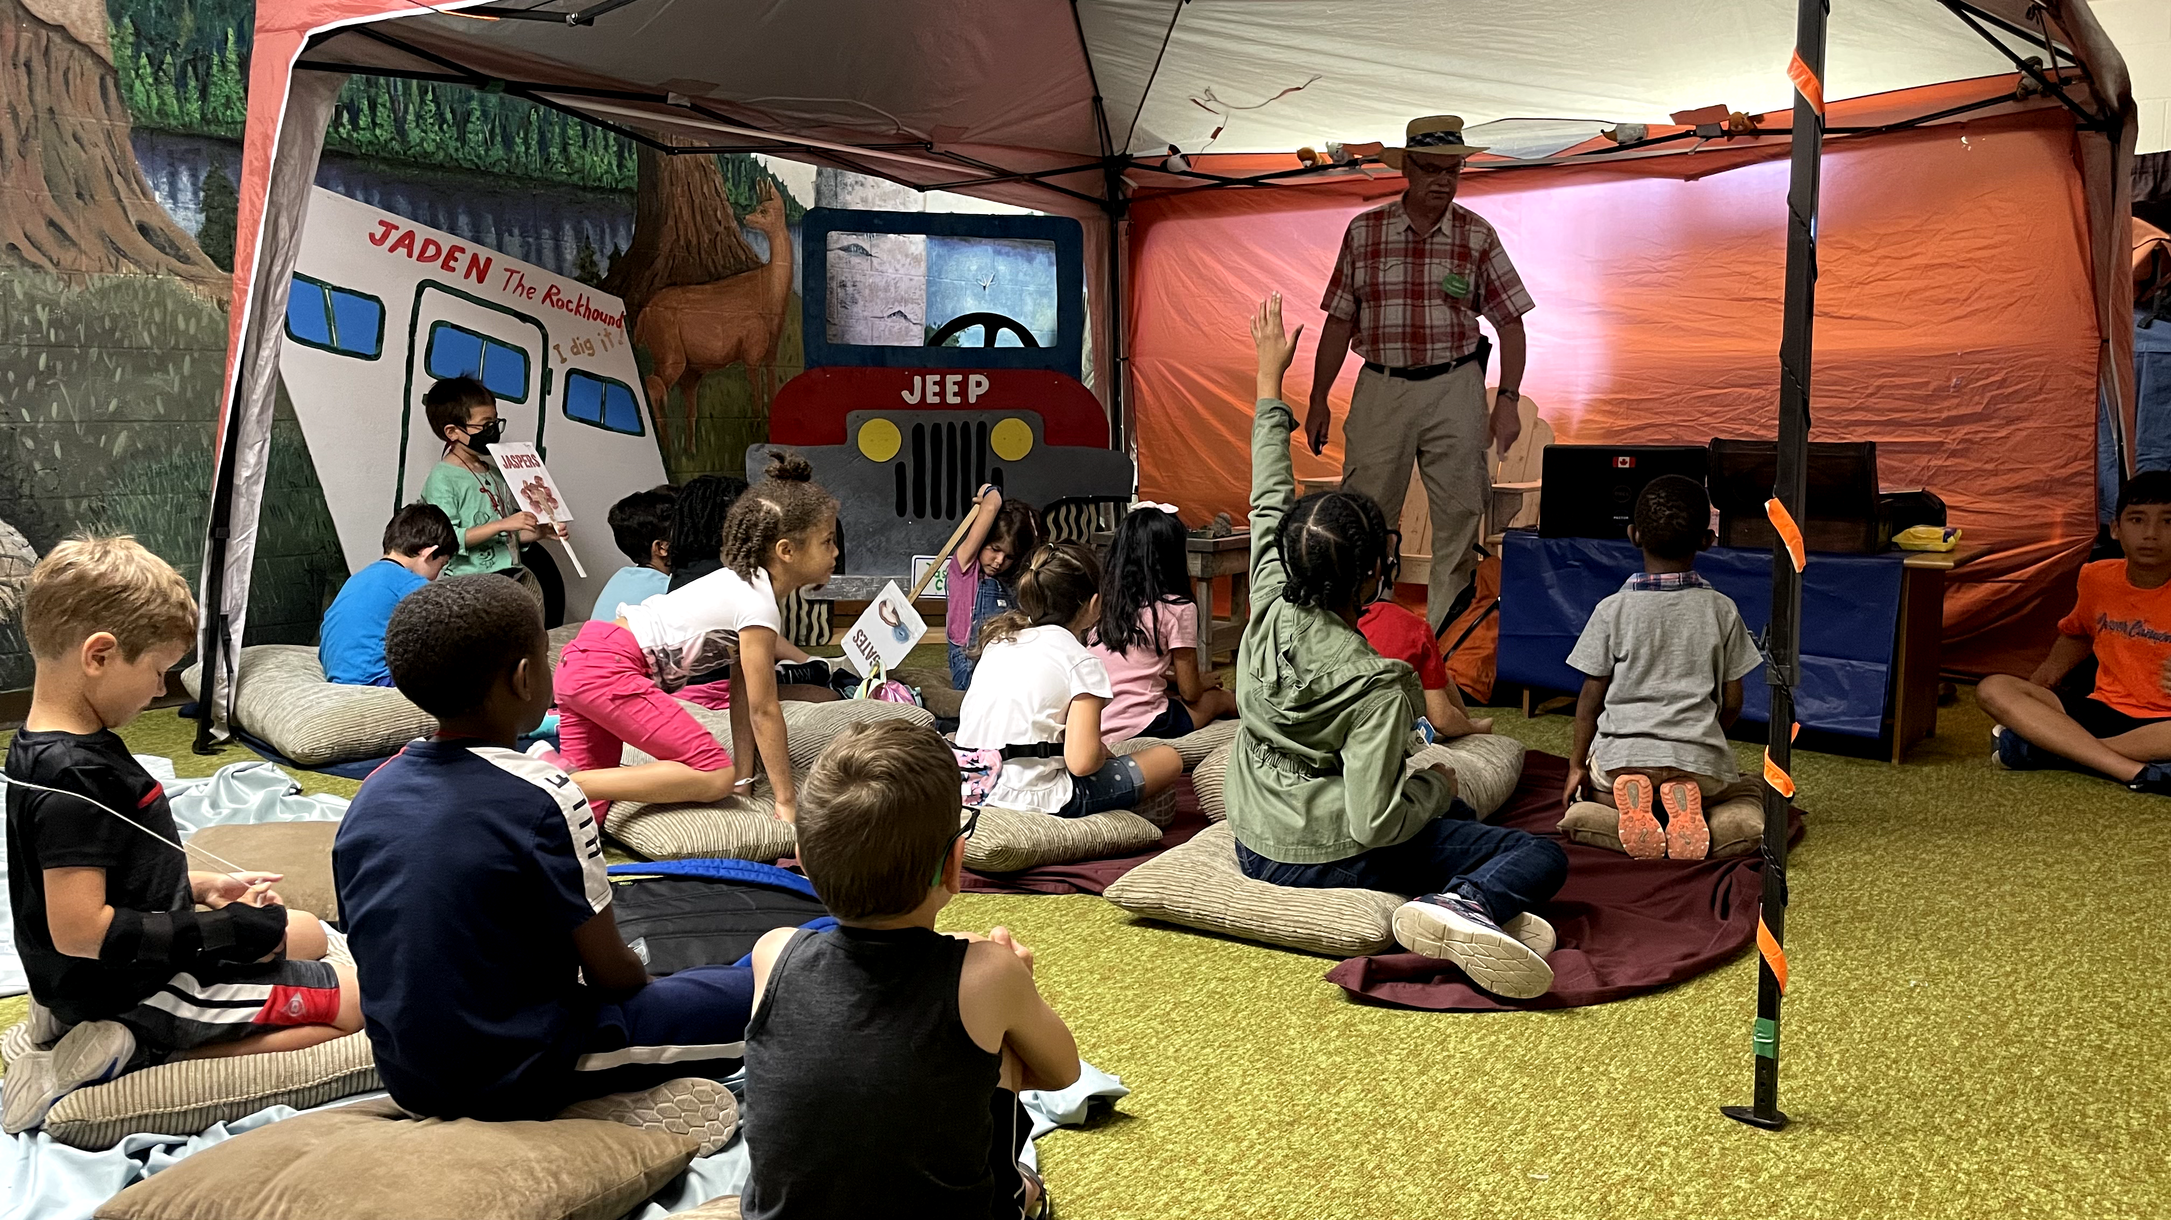
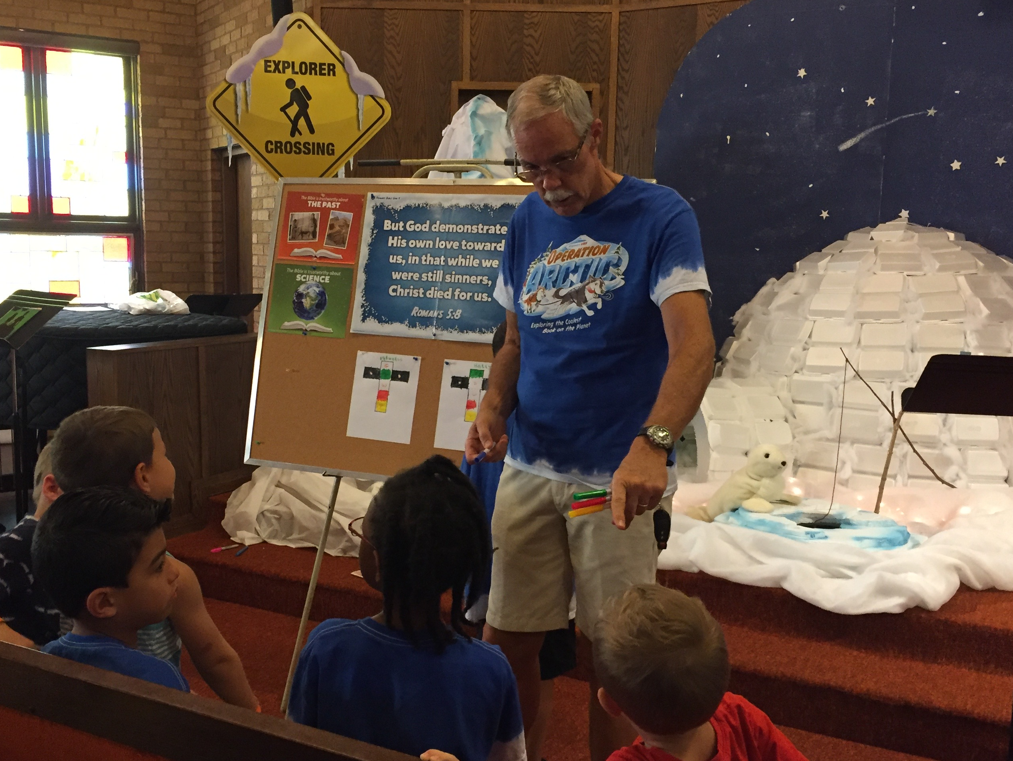
Bible station
・BIBLE- most important part of VBS, make it interactive, bring out spiritual lessons, enact the stories
・Adapt the Bible story depending on the ages –visuals, activities, handouts to take home, etc.
・Decorate the room to give ambience
Notes:
BIBLE- most important part of VBS, make it interactive, bring out spiritual lessons.*
2. Adapt the Bible story depending on the ages –use visuals, act out the story for younger kids (all 5 senses), activities, ask more abstract questions to get the older kids thinking, give out handouts to take home to emphasize the lesson learned, etc. Different companies that produce VBS programs have their strengths when it comes to Bible depth materials – the SDA one has a puppet video. The LifeWay and Answers in Genesis are very strong in Bible information and application. They also provide different level materials (grades 1-2, 3-4, 5-6). You can pick and choose what you want to do, or add your own Bible materials to make it interesting. This is where Kids also make commitments to follow Jesus. So, keep an eye on those who show extra interest or ask questions.*
3. Decorate your room to give ambience.- PR. James*

Slide 15
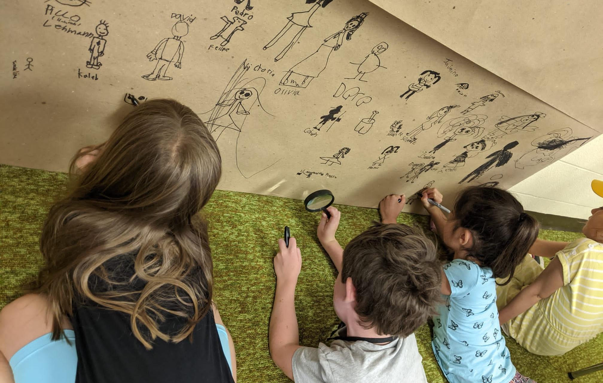
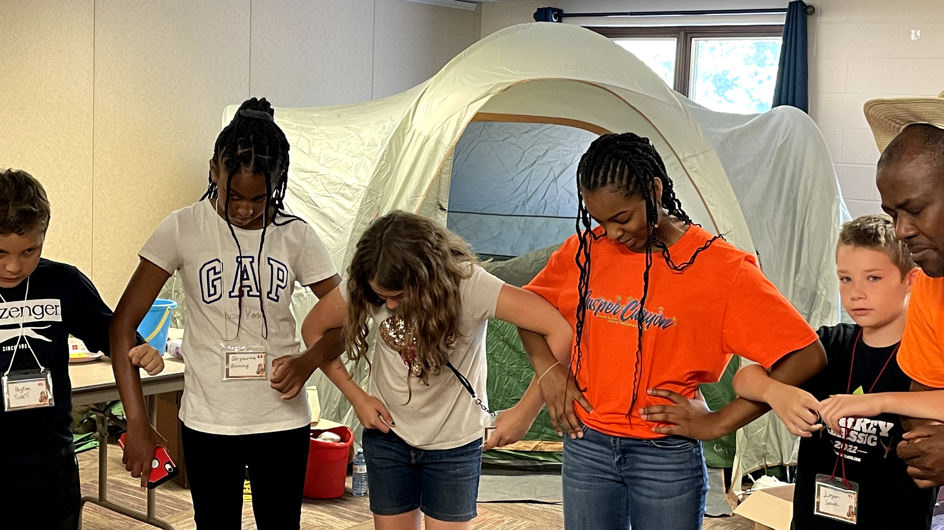
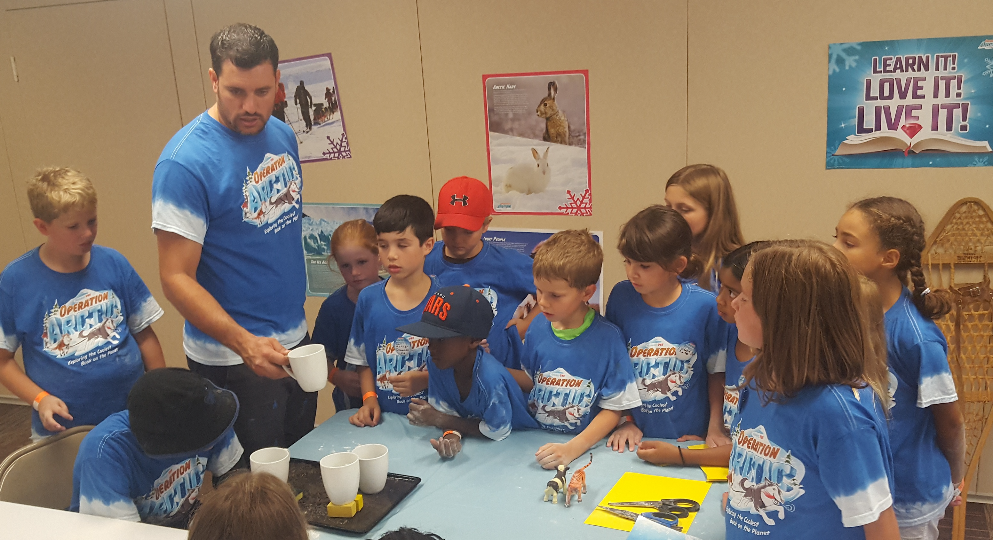
Science (or Prayer) station
・PRAYER –do activities to emphasize the daily lesson, teach about silent and group prayer.
・SCIENCE – learn spiritual lessons through hands on experiments.
・Have enough supplies for kids to do their own activities.
・Have at least one big experiment for kids to remember
Notes:
PRAYER – unique station to only our SDA VBS program. It was a success! Well done.*
-*emphasize what was learned in the Bible station, kids get to do activities, there is a time for silent and group prayer. Many kids are uncomfortable at the beginning, but don’t push them, and slowly they will learn to pray. For some it is the first time they have ever heard about praying from the heart.*
*SCIENCE – learn spiritual lessons through hands on experiments. Most VBS kits have this option and the kids love it, because they get to do things with their hands, so they learn better! But make sure you bring out the Bible lesson. (if no PRAYEr station, add a prayer component to this station).*
* Have enough supplies for kids to do their own activities.*
*Have at least one big experiment for kids to remember*

Slide 16
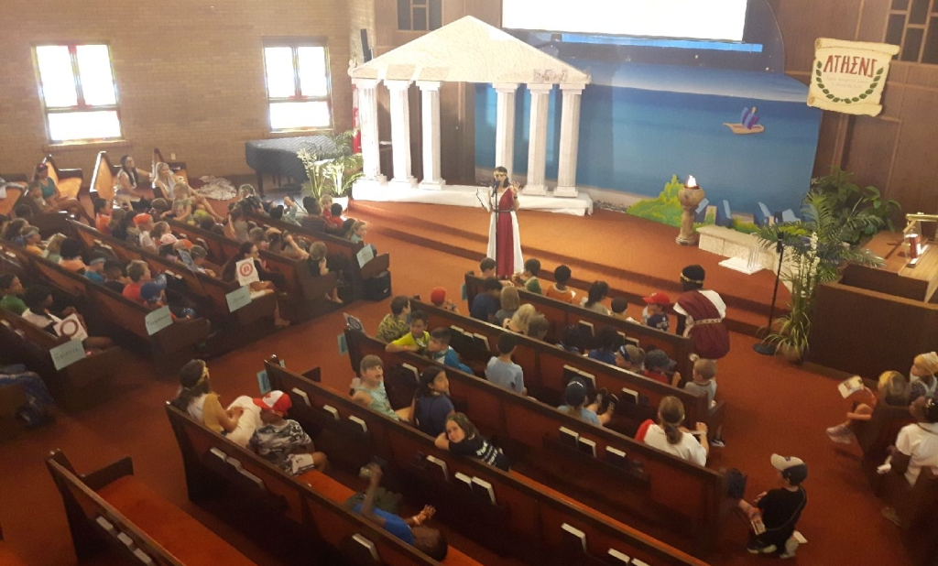
CLOSIng assembly
・Review the daily topic and Bible verse, share the Mission video, offer prizes or share a challenge for next day.
・Share announcements and remind the kids about the Closing /Celebration Ceremony
・As parents come in to pick up their kids, show short videos advertising Pathfinders or Adventurers or other programs that the church offers.
・Dismiss kids in orderly manner
Notes:
After rotating through stations -, everyone returns to Assembly room- *
*song, review what they learned, show Mission video , maybe closing skit. Review Bible verse, maybe offer a prize or incentive, or give a challenge for the next day. The Materials should give suggestions on what to do, but also think outside the box. *
*Remind kids about closing Ceremony, so their families plan on being there*
-*On each days, advertise a kid related program in your church -Clubs -2-3 minute videos*
- *Dismiss kids in orderly manner – Find what works for you –Parents come and pick up kids from Team leader, or a volunteer is responsible to dismiss kids by family? (turn in name tag and show proof that your are the parent)*

Slide 17
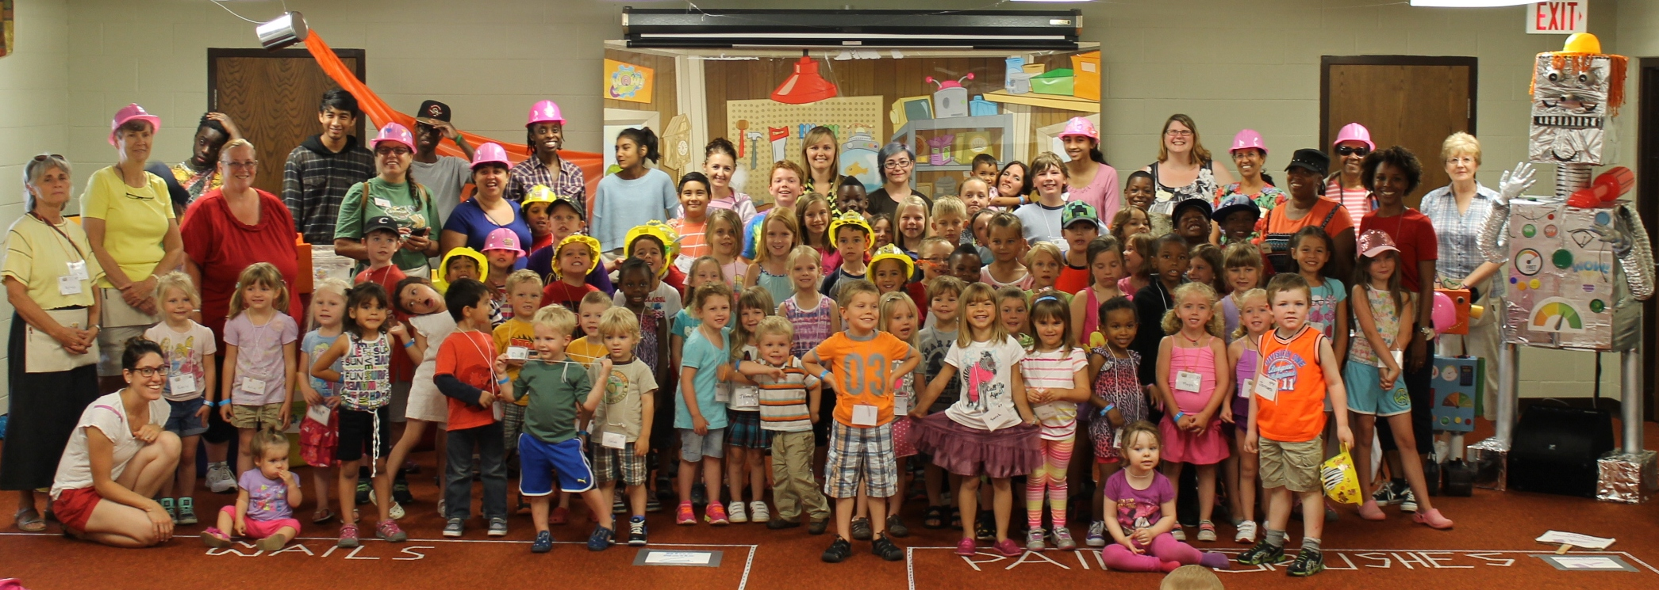
CLOSIng Ceremony (Celebration)
・Do a 45 minutes program to review what the kids have learned during the week.
・Share how much was raised for the Mission project and where does the money go to.
・Invite parents to Church events, PF /Adventurers Clubs, Kids Sabbath school, etc.
・Give out Certificates
・Have a reception or games
・Have church members attending and mingling with visitors
Notes:
CLOSING Ceremony: - a few days before VBS ends, Send out to parents info regarding the Closing night/Ceremony – Friday evening? Or Saturday worship time, or Sunday? Whatever works for you *
-* keep the program short, but show what the kids have learned that week. Involve the kids to be part of it, especially singing.*
*2. If you did a Mission project -share how much it was raised. (ADRA)*
-* 3. This is a good tie to Invite community families to your church events , kids clubs, church services. So, have follow up programs in place already!*
-*4. Give out Participation Certificates to all the kids who came through VBS. And if you choose to give a sharing book to parents , or one SDA kids book for each family, this is a great opportunity.
*5. Have a reception or games/ fun activity right after the Ceremony. *
* This will give a chance for church members to mingle with parents and get to know them. (Mascot attraction, pictures).
Make sure church members bring snacks to share. *
Be ready to let some things go if they don’t follow your plans. Be flexible!

Slide 18
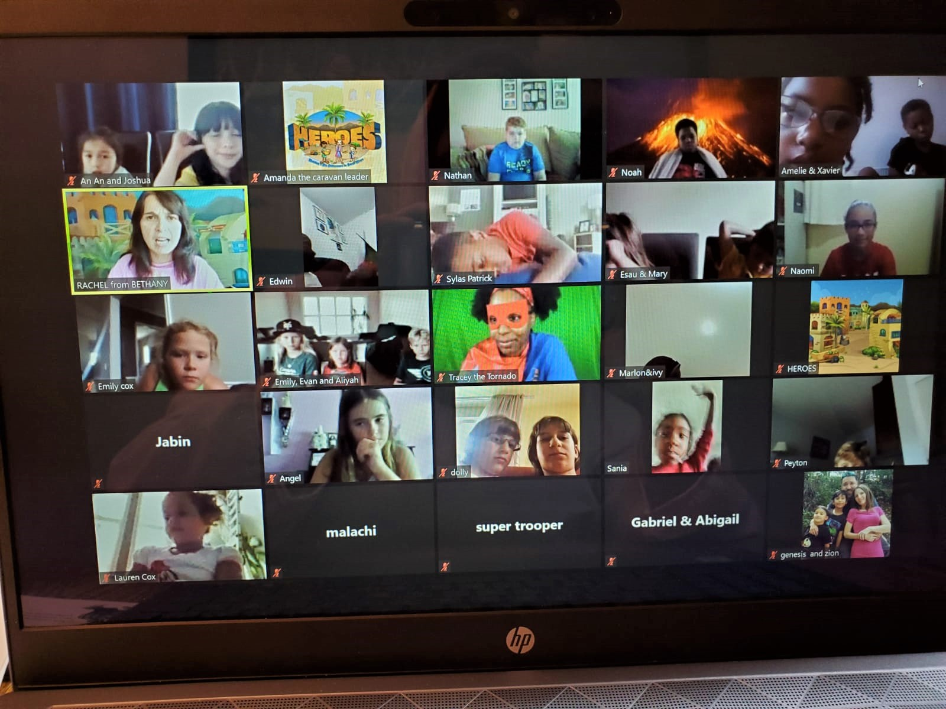
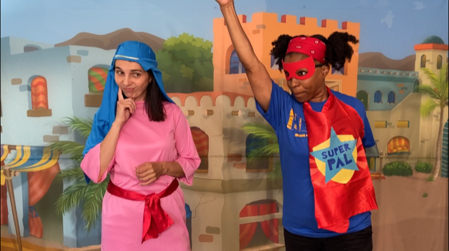
Online vbs
・On ZOOM: Keep it short -1.5-2 hours at the most
・Have families do crafts and snacks on their own and post pictures/videos to a safe site (FB group, Whatsapp)
・Two leaders to lead and 1 Technical person to screen share videos
・Pre-record videos for the Bible station, skit, crafts, science, etc.
・Invite kids from other parts of the world to join the meetings.
Notes:
If for some reason, you want to do an Online VBS, here are a few ideas briefly.: keep it shorter than regular VBS (1.5- 2 hours max)*
*2.Have families do activities during the day (crafts) and share pictures/videos to a safe site (or FB page, so everyone feels connected somehow)*
-*3. Have two leaders at the time to take turns. If the internet goes down for one, the other can take over. (Ex: HEROES, Sharon –modern character). Have a technical person who has good internet and shares all the videos.*
*4. Prerecord skit videos, Bible, Crafts instructions, Science station. The HEROES VBS came with prerecorded videos. Add LIVE interactive games (scavenger hunt etc)
*5. Advantage: - kids from other parts of the world attending.
Set rules from the beginning (chat, mute.unmute)
If families live close to each other, plan to meet for games/activities*

Slide 19
The secret of success is the union of divine power with human effort. Those who achieve the greatest results are those who rely most implicitly upon the Almighty Arm.
Patriarchs and Prophets, pg. 109,EGW
Notes:
Lean on God for help during the week of VBS. And Communicate OFTEN with your staff members!
Show love to the kids you meet.
In closing, join FB groups for tips and ideas on how to run VBS programs. If you have specific questions, You can also email me at ___
Questions and Answers

