Slide 1

Preparing for VBS
Let’s get ready!!

Slide 2

Agenda
What is your focus?
Plan for success
Involvement – Pastor & volunteers
Budget
Advertising to children and families

Slide 3
What have children experienced prior to the VBS Experience?
Inconsistency Unpredictability
Social disconnect- loneliness
Isolation
Increase in technology for communication
Kindness
Compassion
Relationships with a loving caring adult helps to build resiliency
Notes:
VBS Program is created with Trauma informed focus, with the understanding that some of the children in ways have experienced some form of Trauma.

Slide 4
VBX Experience
At this Vacation Bible School kids will follow Ruth and Naomi’s journey from Moab to Bethlehem. Along the way, they’ll love learning how God always keeps His promises! Five days of Christ-centered activities will help kids see that God is always faithful.
The VBS is set at the Mazan Oasis that is on the road from Moab to Bethlehem

Slide 5

What is your focus?

Slide 6
VBS is an Outreach program to your community
Community and church member partnership
Some children may not be connected with the church or any religious background
When you interact with children use their names – use name tags
Plan for children with special needs/exceptionalities – may need assistance
Notes:
Don’t Assume that children know anything about the Bible
Using names is a strong way to build relationships with them
Gather information from the parent/Guardian about the needs of the children and effective strategies that will support the child

Slide 7

PRAY
What have our children experienced before coming to VBS?
Notes:
Ask for the help of the Holy Spirit, Volunteer who Value Children, Children, Supportive guardians and parents
God for his purpose to be at the forefront of what you do

Slide 8

Plan for Success

Slide 9
Plan ahead
Dates and Times – 3 hour program, full day, ½ day? – 4 days – 1 week
Who is part of your planning team?
What kind of program will you facilitate? Online – face to face
What is the grouping? Large Group – Small Group
Discuss - Where the VBS Program will take place
Notes:
We have to think about protecting our children – Volunteer Screening

Slide 10
Involvement
Volunteers
  Children’s Ministries assistance
  Photographer/Video
  First Aid Provider (Nurse)
  Registration
  Cook (Lunch/Snacks)
  Training and regular meetings
  Cleanup Crew - Washrooms
  Look for leaders
  Donations - $$, decorations and supplies
  Will you have a program for parents/guardians?
Pastor
  Support to communicate with the congregation – to Pray
  Partner with other departments (Personal Ministries hand out invitations, pray)
  *Appreciate everyone involved

Slide 11

Budget
Look at previous VBS costs – consider food , supplies, materials, decorations
Fundraising
Stick to your Budget – Church approves budget
Budget your TIME (Meeting once a week – 3 hours including a 1 hour meeting)

Slide 12
Example - VBS Budget -- $1350.00 – 6 hour program (lunch and 2 snacks included)
Food order -- $850.00 (4 days)
(35-40 children + 14 volunteers)
Decorations and supplies - $300
Art Supplies - $150
Promotional costs - $50
Donations of food, materials and art supplies
MENU
Mon - Sandwiches
Tues – Spaghetti
Wed – Rice and Veg dish
Thurs – Pizza
Saturday Celebration Gift – knapsack, chips, pencil and juice boxes
Certificate
Cake and light refreshments

Slide 13
Advertising
Online – Church Website
Community Visits – hand out invitations in the neighborhood
2 months prior to VBS – Information booth at the church (invitations)
Give children incentives to invite their friends
Send out invitations to past attendees – mail out
VBS promotional videos – ask for volunteers too.

Slide 14

Time lines
- Get prepared

Slide 15
3 to 6 months
Select your format for VBS & VBS Kit
Pray for your program
Where are your activities taking place in the space?
Plan for your budget
Ask for donations – supplies, crafts, food etc.
Connect with your Pastor

Slide 16

Fiercely Faithful Complete Kit Includes:
Director’s Guide
Station Manuals
Music DVD and CD
Opening and closing skit
DVD and Script
Mission video
Bible Station Puppet Video
Sample Travel Pal
Resting Point posters
Bible Promise posters
Station posters
Kits available in English & Spanish
Notes:
The Fiercely Faithful Complete Kit Includes
Director’s Guide
Station Manuals
Music DVD and CD
Opening and closing skit videos
Mission video
Bible Station Puppet Video
Sample Travel Pal
Resting Point posters
Bible Promise posters
Station posters
Kits available in English & Spanish

Slide 17

Order Your Starter Kit Today
$159.99/kit + shipping
Kits available in both English and Spanish
Kits are Ready to Ship NOW!
To order visit :
AdventistVBS.org
AdventSource.org
or call AdventSource at 402.486.8800
Notes:
(read PPT)

Slide 18
2 to 3 months
Recruit Station Leaders
Volunteer Training – talk about clothing, supporting children assign small groups
Publicity – Advertising in church and community (online and face to face)
Pre-registration
Solidify the budget

Slide 19
8 weeks
Church Board budget approval
Look at your decorations and supplies from previous VBS
Send out invites to children from past VBS events
Continue with planning meetings – lunches
Look at leadership – First Aid (create an accident report form), Registration leader, Team Leads
Plan follow up activities when VBS is over – Celebration day (Sabbath A.Y. Program) – Date and Time?

Slide 20
4 weeks
Trial with station leaders
Work with cooking or staff to refine menu and food order
Order supplies – volunteer T-shirts
Song leaders – copy of the Song CD’s – practice, practice and practice
Have live advertising for VBS – so children can see some of the volunteers
Notes:
- Suggestion could be if you have youth volunteers and the need their volunteer community hours for high school and even potential employment – have certificates that include their hours given to them at the celebration – so that they have something tangible to verify their participation

Slide 21
2 weeks
Check with station Leaders to make sure they have everything
Decorating committee
Teach VBS songs to everyone involved
Review registration and purchase supplies with estimated numbers
Review format based on registration
Walk through areas and make sure spaces are clean and safe

Slide 22
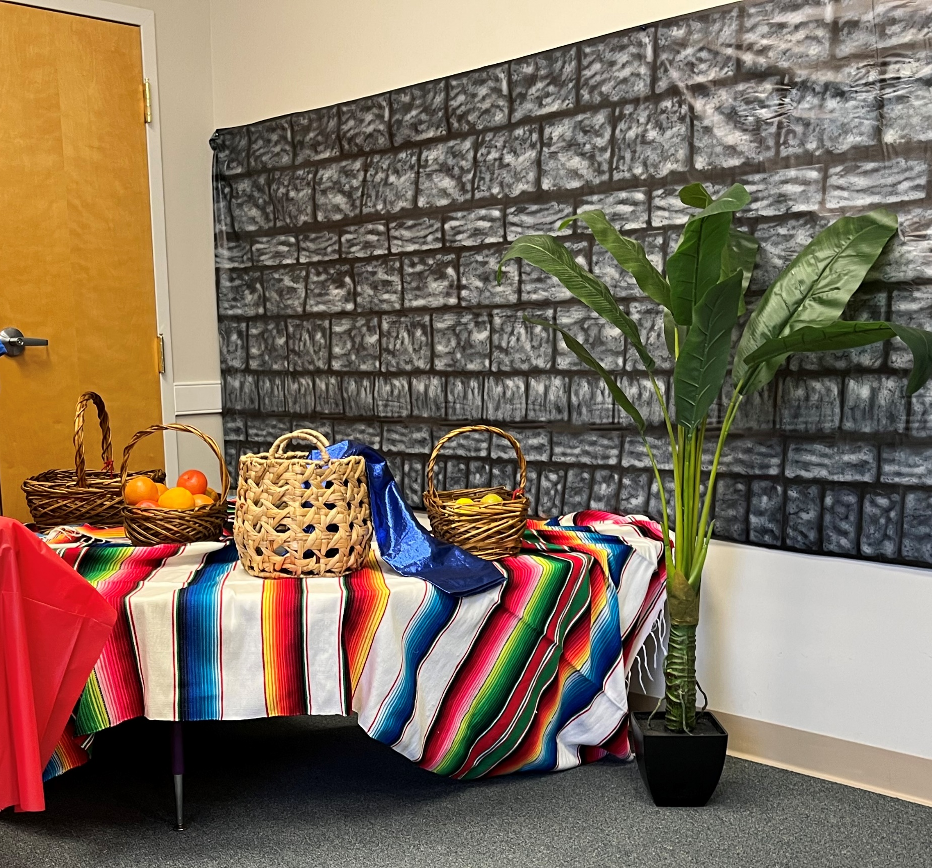
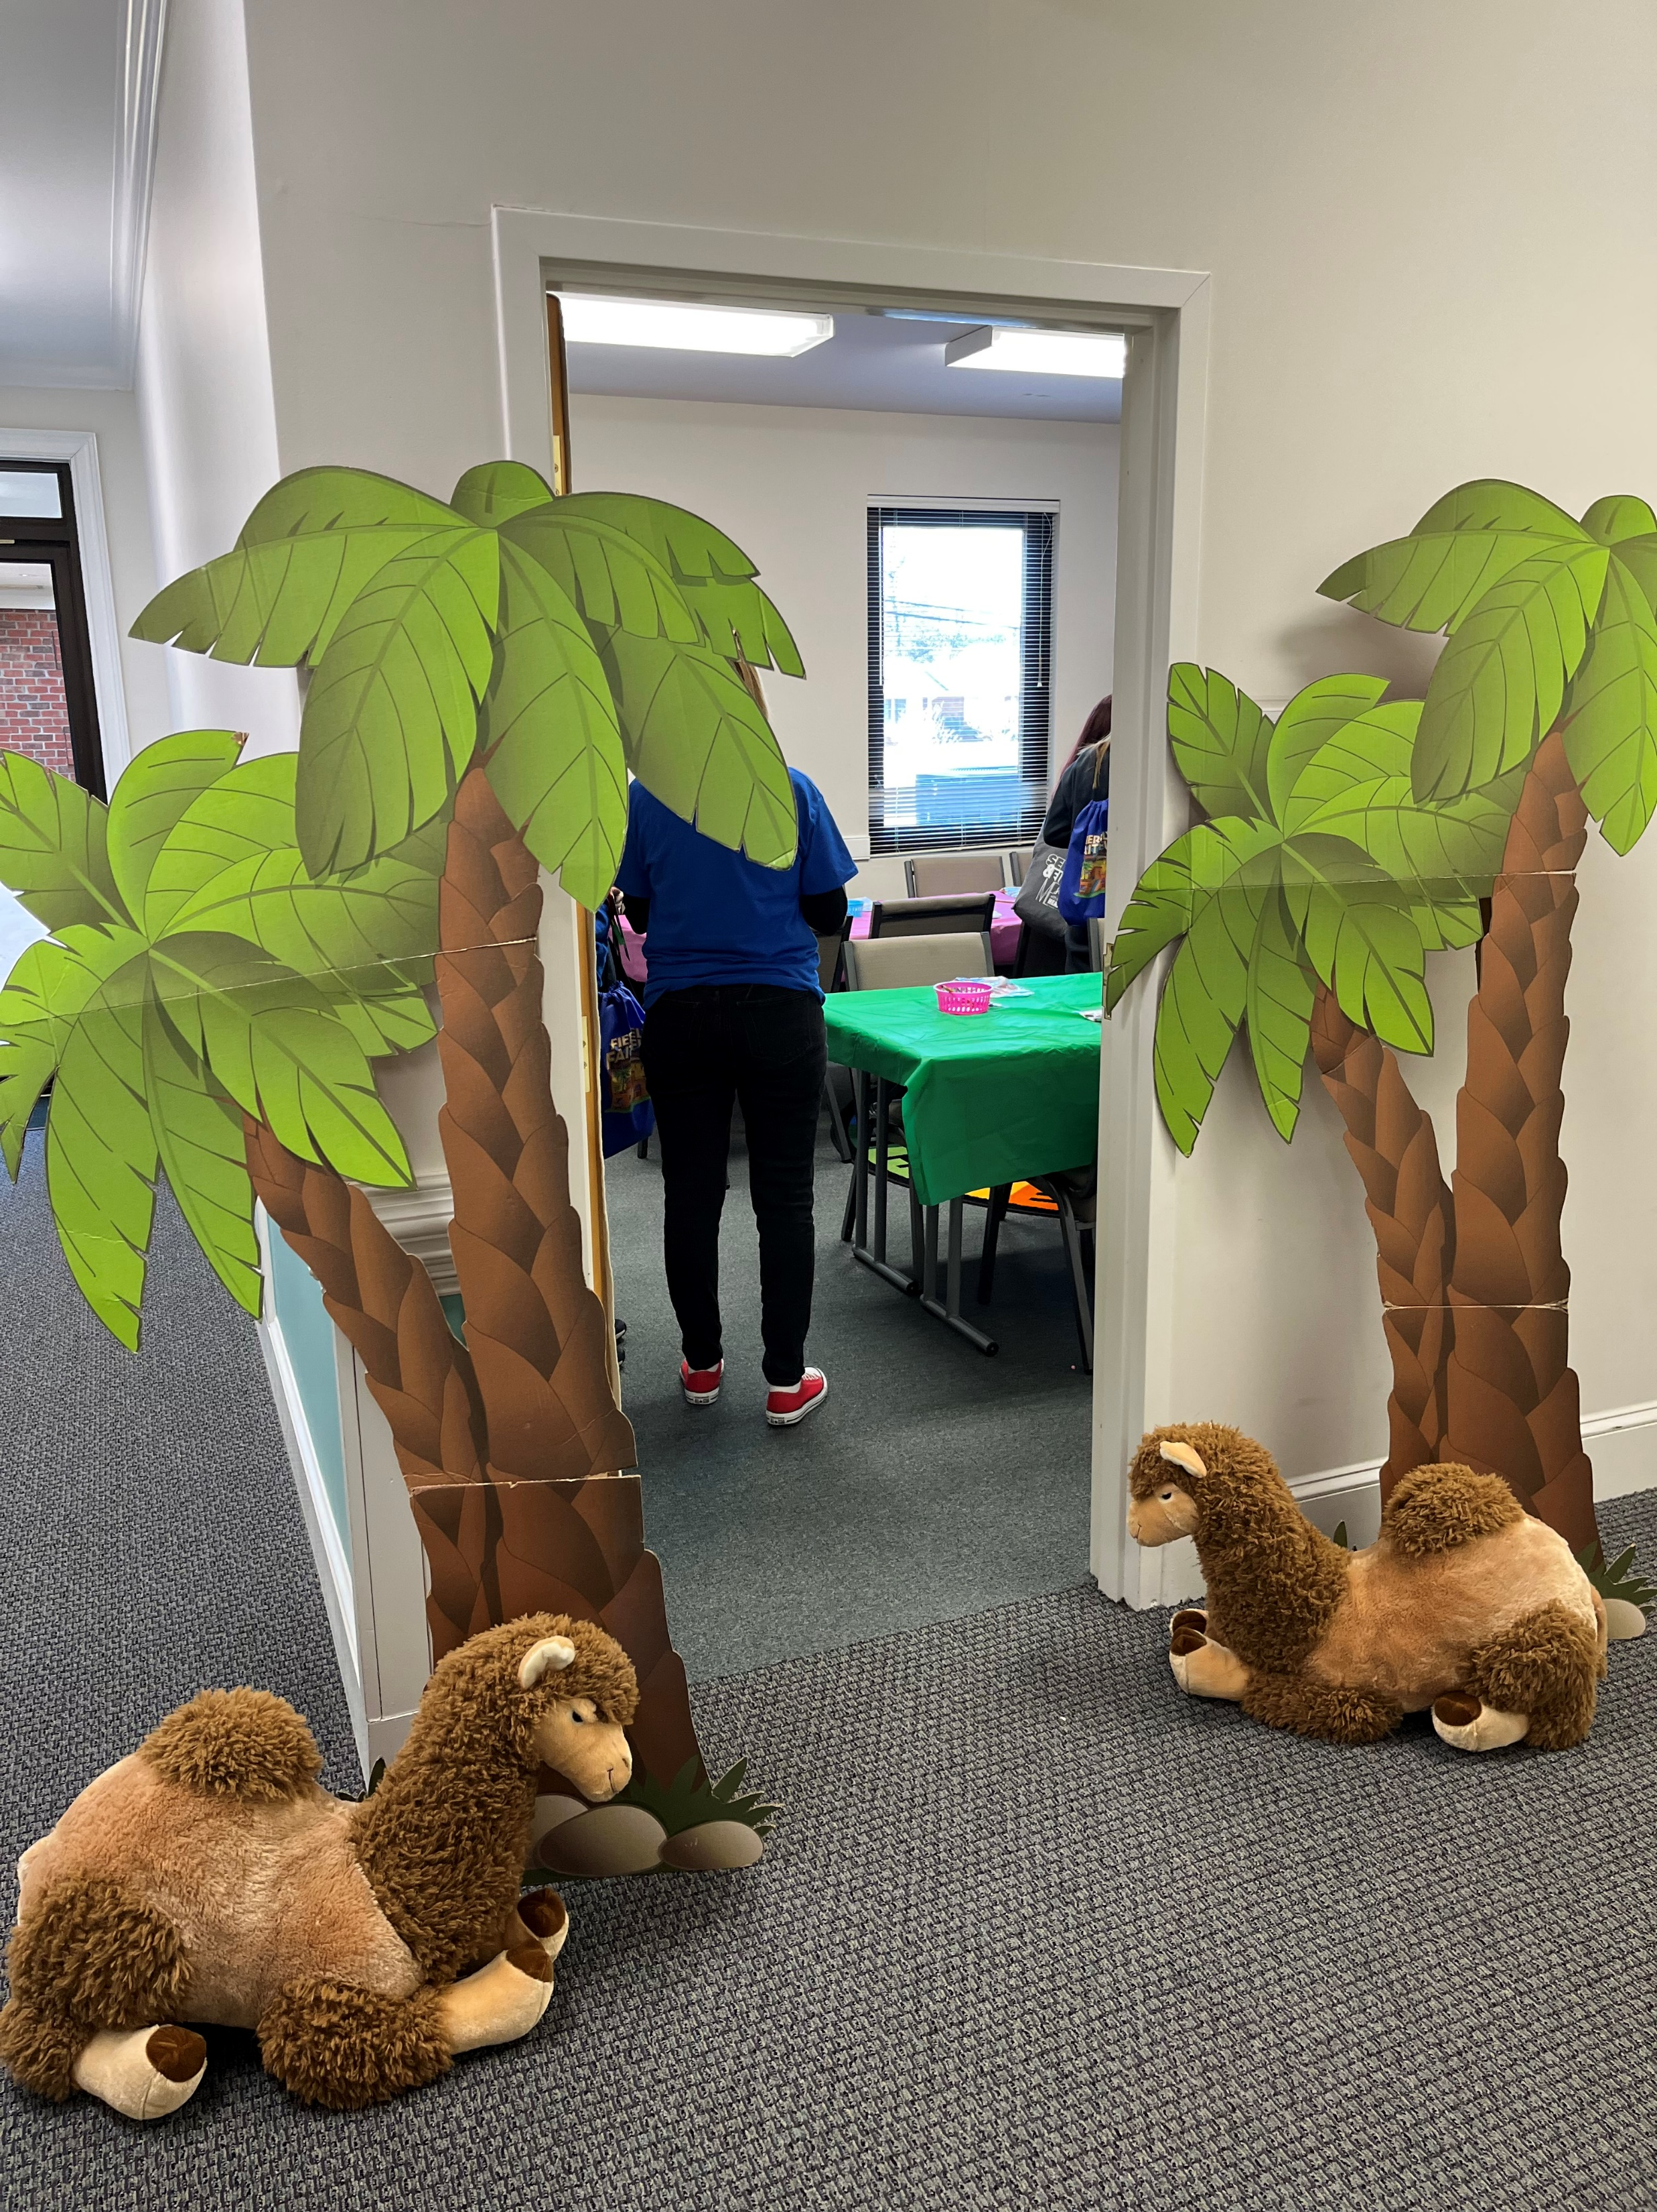
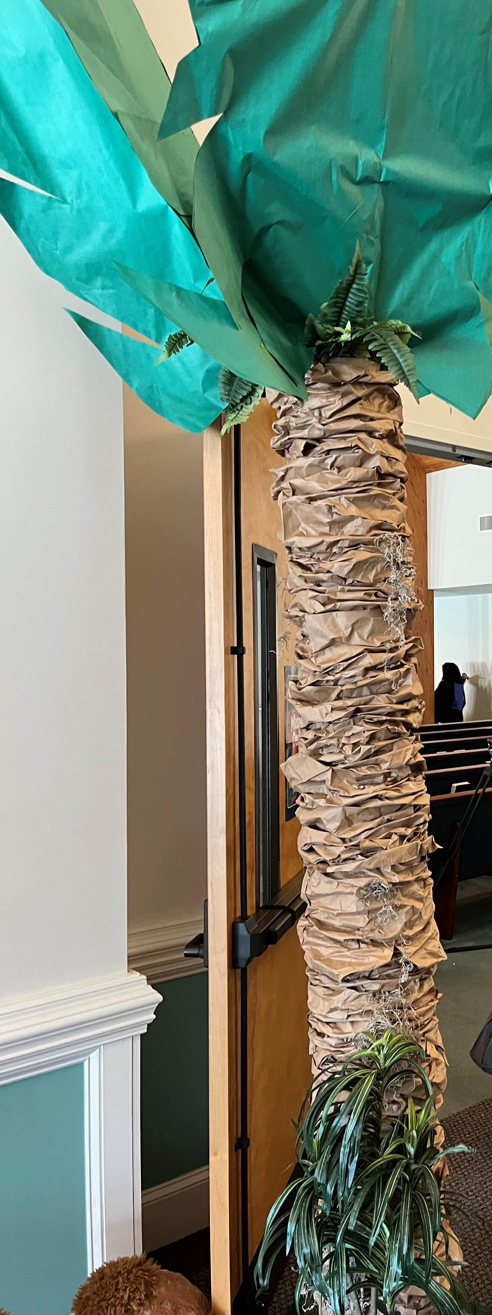
Decoration ideas

Slide 23
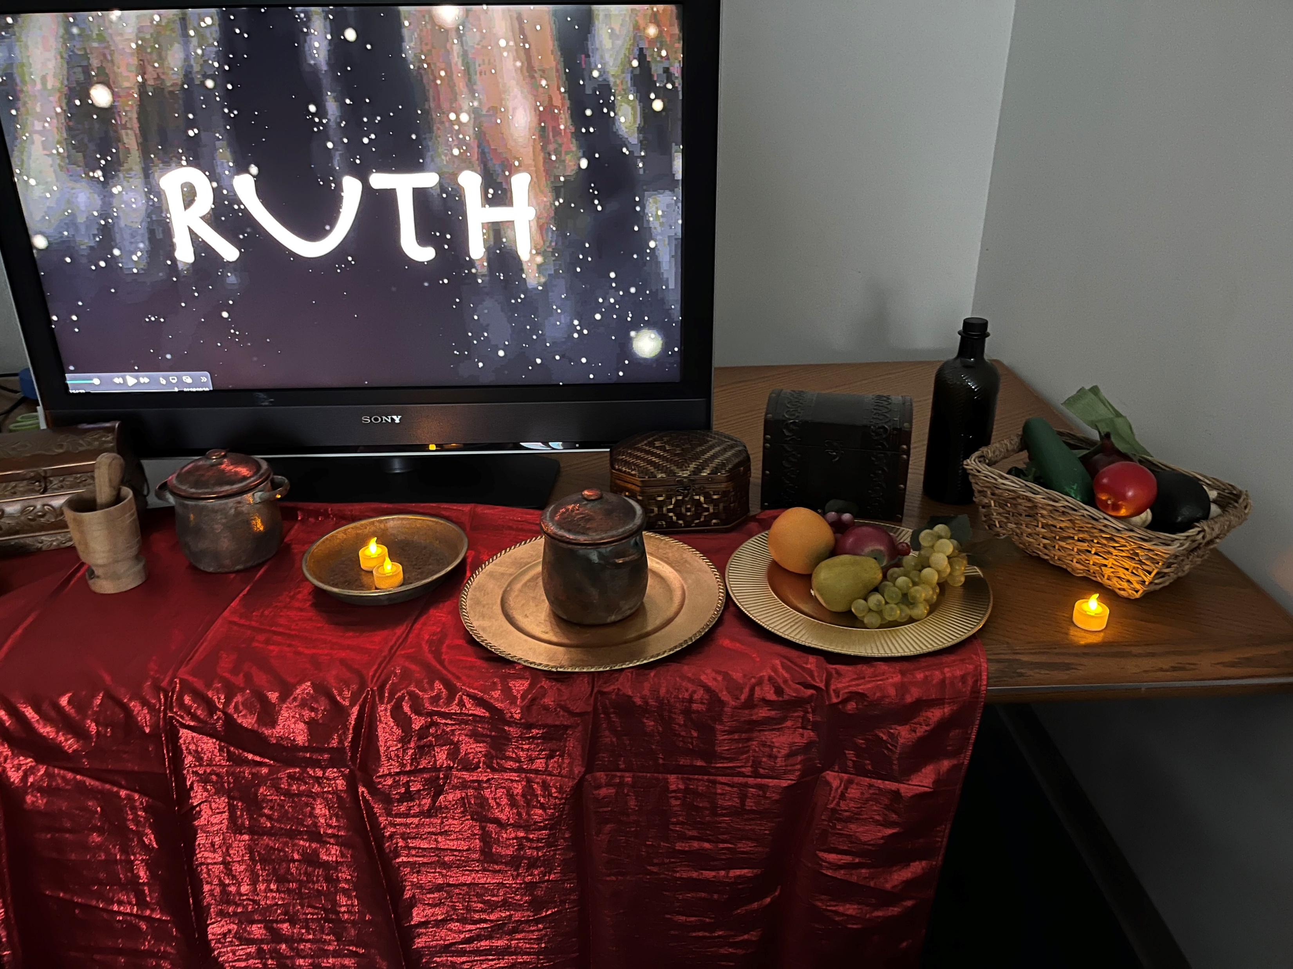
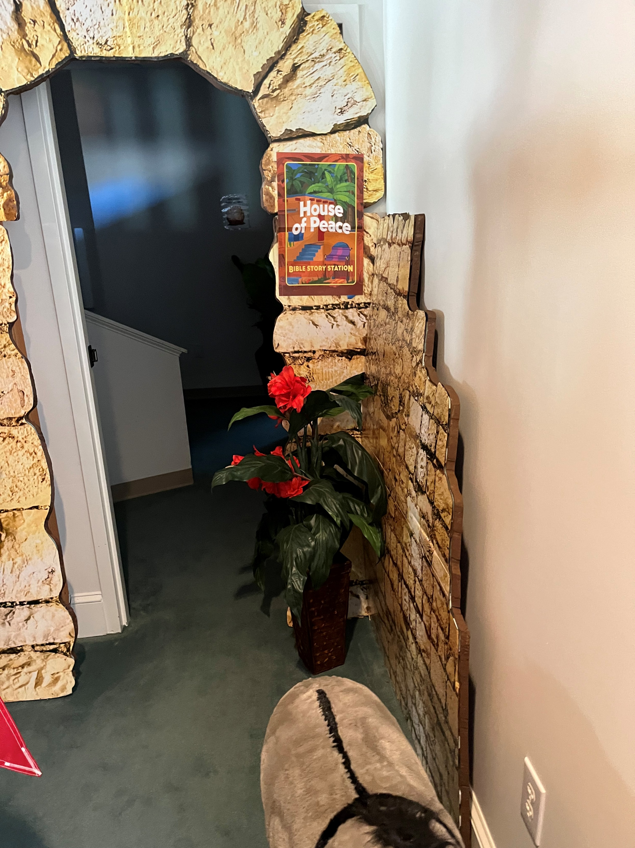
More décor ideas

Slide 24
1 week
Decorations
Last minute supplies?
Have a prayer walk through – with leaders pray for each program area
Have a practice time with volunteers – case scenarios of what to do when potential challenges arise - emergency, fire drill (with children), child gets hurt, teasing, bullying, child lost (head count at each station)

Slide 25
Throughout the program
Daily meetings in the beginning and end of the day (What worked? What can we do better? What can we celebrate?)
Look for opportunities to build relationships with families and children – take time to chat (Director and Registration)
Training with volunteers is ongoing
Always check decorations each day and touch up as needed
Debrief with the pastor
Create Thank you notes for all participants
Create the Certificates for attendees
Consider storage of materials that were not used and where to store them safely

Slide 26

Remember.. do not lose focus
Psalm 127:3
“Children are a gift from the Lord; they are a reward from him.”
Isaiah 54:13
“All your children will be taught by the Lord, and great will be their peace.”

Slide 27

All the best with your VBS

